Slide 1
Keratin extraction
The 3 Rs and the Products of the Future

Slide 2
Introduction
What is keratin?
Keratins are the most abundant group of insoluble and filament-forming proteins produced in epithelial cells of mammals, birds, reptiles, and humans. As structural components of wool, nails, horn, feathers, and hair, they exploit mechanical support and protective functions against the environment. (Reichl, 2009; Wang et al., 2016)
Reichl, S. (2009). Biomaterials films based on human hair keratin as substrates for cell culture and tissue engineering. Biomaterials 30, 6854–6866. doi: 10.1016/j.biomaterials.2009.08.051 | CrossRef Full Text | Google Scholar
Wang, S., Taraballi, F., Tan, L. P., and Ng, K. W. (2012). Human keratin hydrogels support fibroblast attachment and proliferation in vitro. Cell Tissue Res. 347, 795–802. doi: 10.1007/s00441-011-1295-2 | PubMed Abstract | CrossRef Full Text | Google Scholar

Slide 3
Keratin
Synthesis of Alpha-keratin with red keratin to follow throughout diagram. Picture: Mlpatton, CC BY-SA 4.0, https://commons.wikimedia.org/w/index.php?curid=56888235, via Wikimedia Commons
Schematic diagram of wool fibre structure. Picture: Textile and Fibre Technology, CC BY 3.0, www.scienceimage.csiro.au/image/2490/, via CSIRO

Slide 4
Keratin
Why is Keratin extracted from wool?
Keratin is extracted largely from wool. This way the wool is recycled and not wasted.
Can wool be recycled infinitely?
The answer is no, because the regeneration cycle of a fibre is not infinite. Every time a fibre is regenerated, its length shortens. For this reason, each material has a well-defined regeneration cycle. For instance, wool and cashmere can be recycled up to 4 times.
Upcycling wool: https://youtu.be/5UJLCJkH3dk

Slide 5
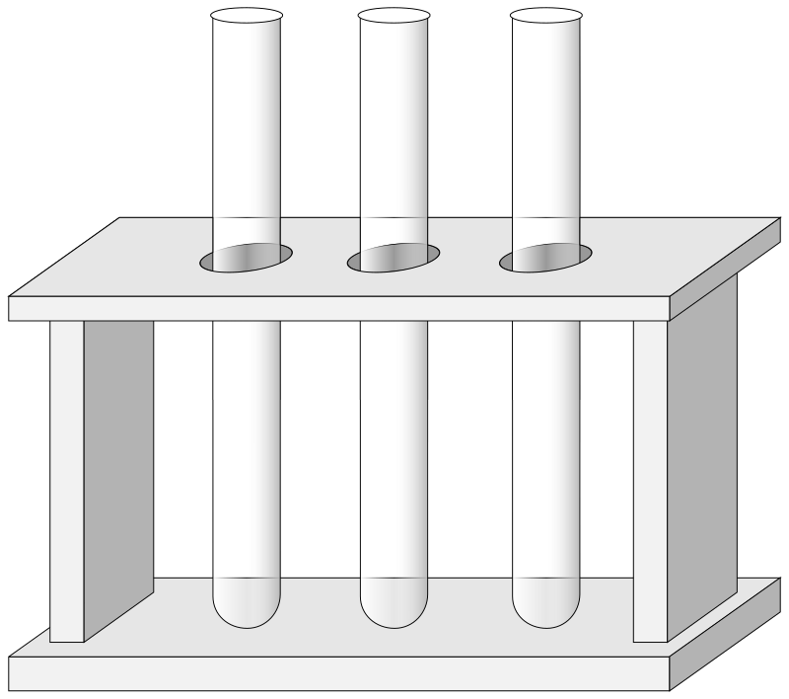
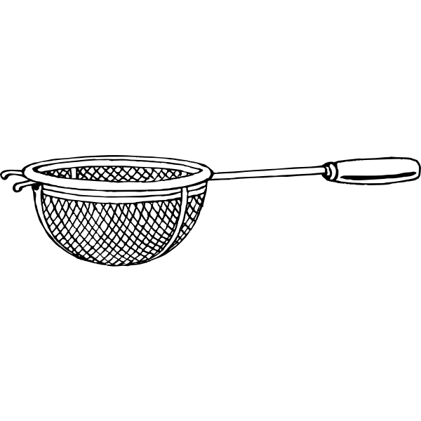
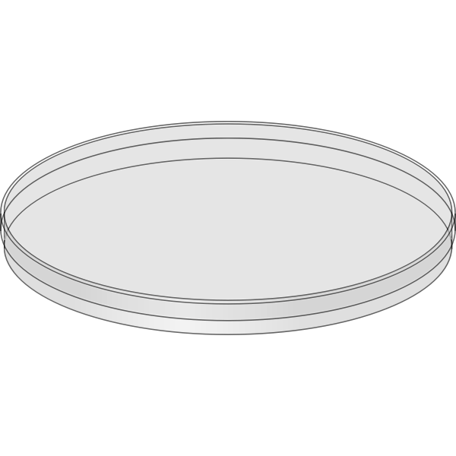
Tools
Beaker 150 ml
Glass rod
Test tubes
Rack
Strainer
Pipettes
Safety goggles
Petri dish

Slide 6
Materials
Extraction
NaOH (1 M)
Raw wool
Flocculation
Lemon Juice
Ethanol (CH3CH2OH)
Acetone (Dimeltichetone, CH3-CO-CH3)
White wine vinegar

Slide 7
Method for keratin extraction
Wear protective gloves, a lab coat, and goggles.
Put the wool fibres in a beaker.
Cover them with the sodium hydroxide solution and mix the mixture with the glass rod.
Let it stand for at least 30 minutes.
Extract a part of the fibres from the extraction solution and observe their appearance.

Slide 8
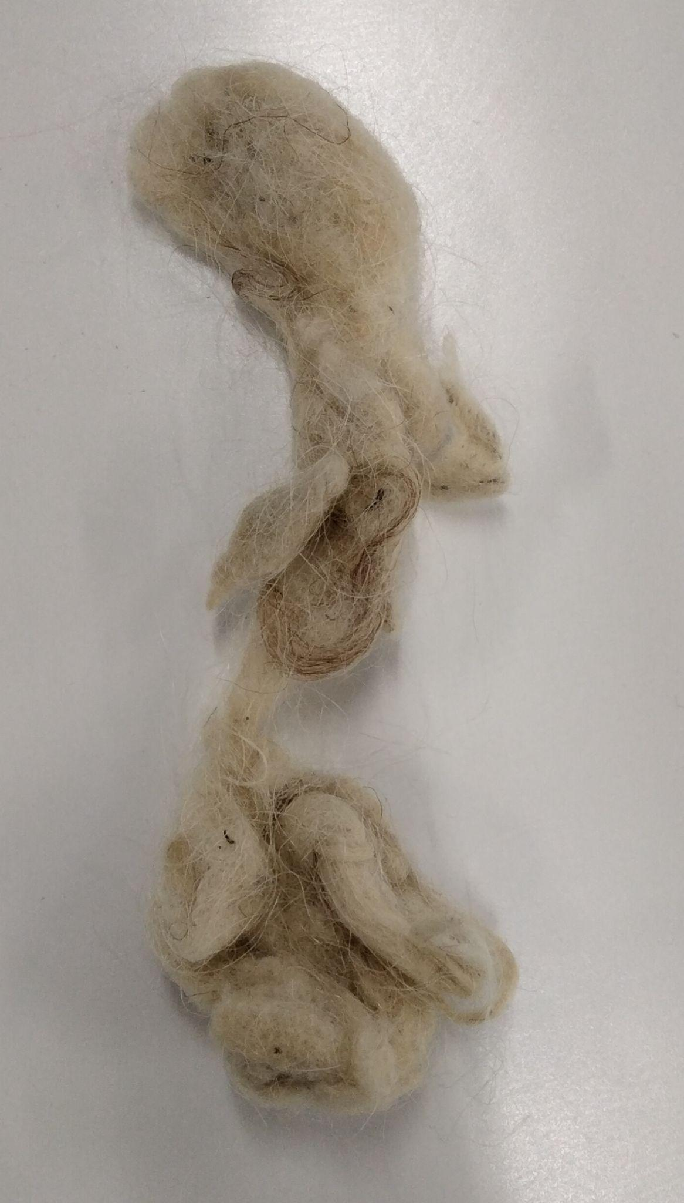
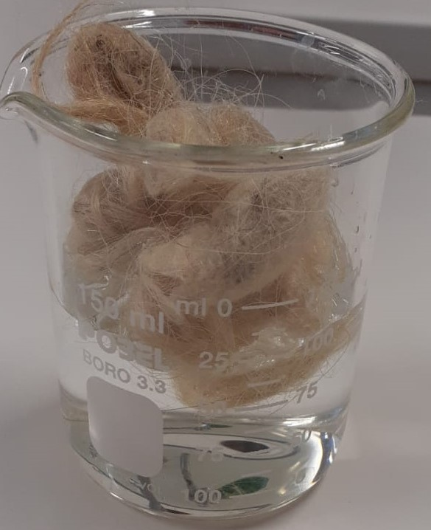
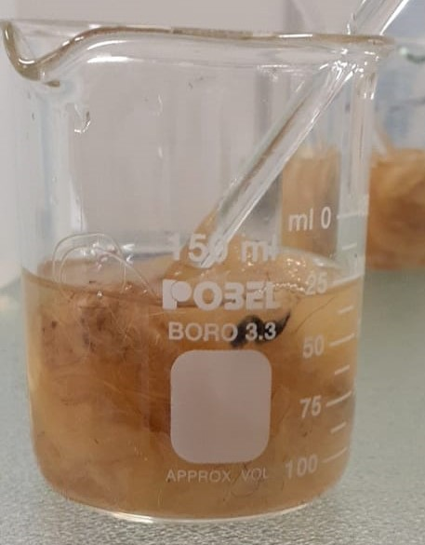
Method for keratin extraction
Wool before the experiment
Wool in a beaker with sodium hydroxide (NaOH)
Mix the mixture well with the glass rod

Slide 9
Results of keratin extraction
Appearance of the wool before extraction: | White colour, soft, crimps or not
Appearance of the wool after the extraction period: | The wool takes on a dark colour and a gelatinous appearance.
Appearance of the extraction solution at the end experience: | The clear and colourless solution at the beginning becomes dark and cloudy.

Slide 10
Method for keratin flocculation
Wear protective gloves and goggles.
Strain the lemon juice.
Take five tubes, mark them and add about 10 mL of different solutions in each one: ethanol, acetone, citric acid, vinegar, lemon juice.
Add about 1-2 mL of the extraction solution drop by drop to each tube and complete the table below with your observations.
Pour the contents of each tube into a petri dish and let it evaporate until it is completely dry.
Observe against a dark background and report your results in a table.

Slide 11
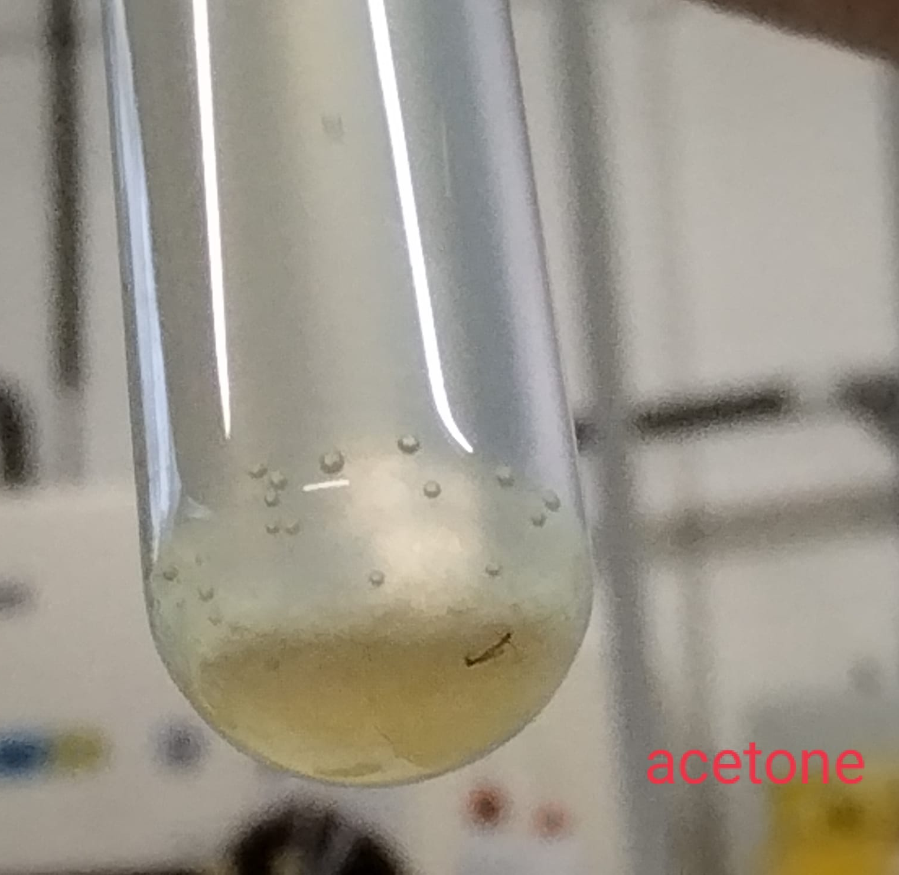
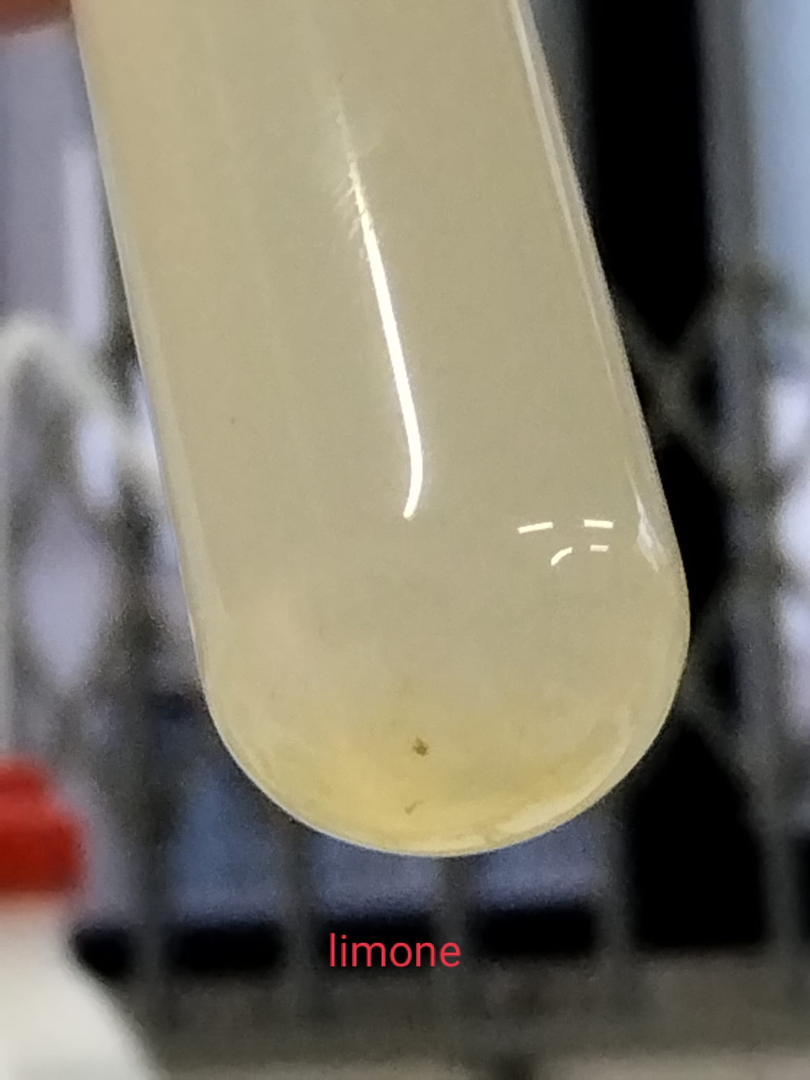
Method for keratin flocculation
acetone
alcohol
vinegar
lemon

Slide 12
Results of keratin flocculation
Acetone | Vinegar | Alcohol | Lemon juice
the solution becomes cloudy the protein settles on the bottom of the tube | The solution becomes cloudy the protein settles on the bottom of the tube | the solution becomes cloudy the filaments initially remain in suspension and then settle on the bottom | the lemon juice does not allow the vision of flocculation you can observe stratifications

