Slide 1
Plastic and the 3 Rs:
Reduce, Reuse, Recycle
The 3 Rs and the Products of the Future

Slide 2
Reduce
To "reduce" means to limit the amount of things we throw away.
What do you think is the most effective way to reduce waste?
Use paper bags
Not create it in the first place!
Use biodegradable bags

Slide 3
Reduce
Can you think of ways to reduce plastic?
Bring your own shopping bags
Use a reusable water bottle or cup for beverages and containers for lunch
Say no to disposable straws and cutlery
Do not use the plastic produce bags
Store leftovers in glass jars
Share your tips with family and friends
…

Slide 4
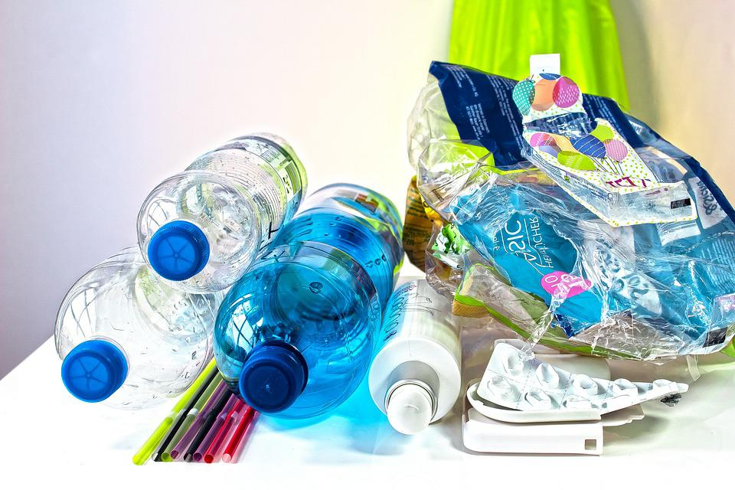
Reuse
To "reuse" means to use an object again instead of throwing it away.
Can you think of ways that you could reuse a plastic bottle?
Photo by Stux via Pixabay

Slide 5
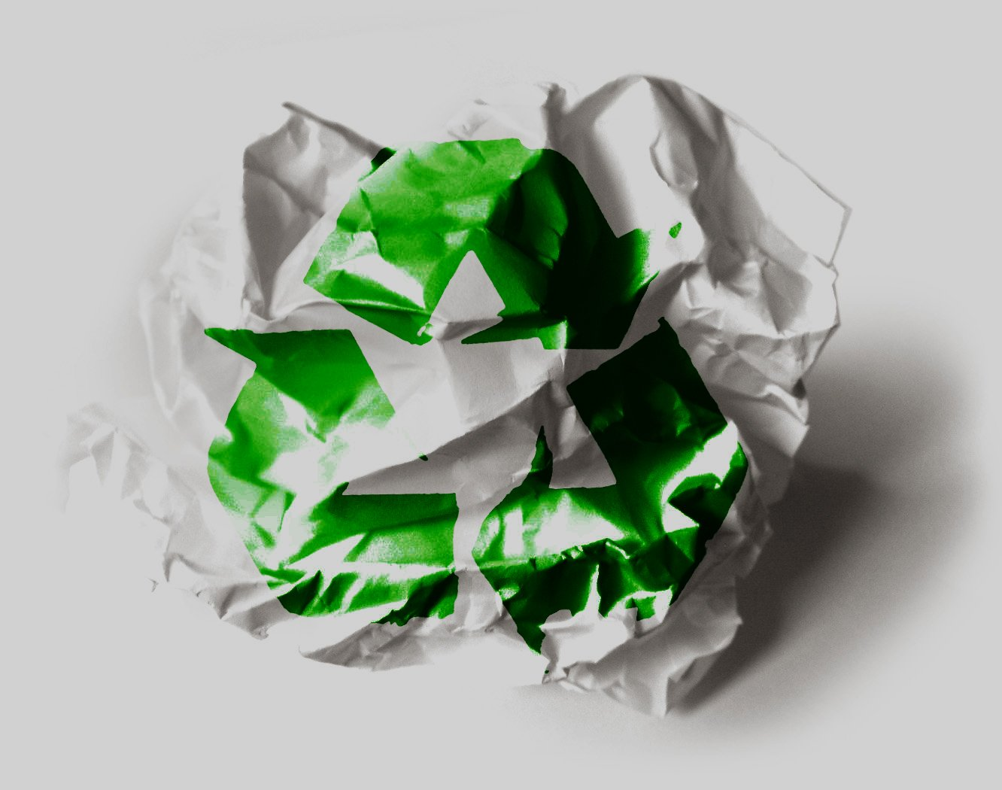
Recycle
To "recycle" means to take a product that can no longer be used and have it sent to a recycling center to be broken down and made into something new.
What can you do? Think of everyday things you can do to reduce, reuse and recycle!
FreeImages Recycle by Jay Lopez

