Slide 1
Recycling Polylactic Acid
The 3 Rs and the Products of the Future

Slide 2
Recycling Polylactic Acid
Experiment:
Step 1

Slide 3
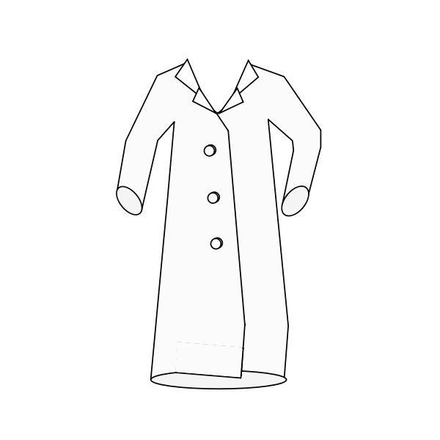
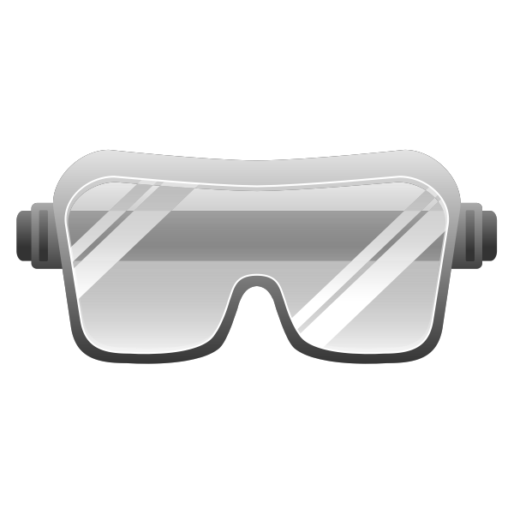
Step 1
Safety first: put on a lab coat, protective goggles and gloves.

Slide 4
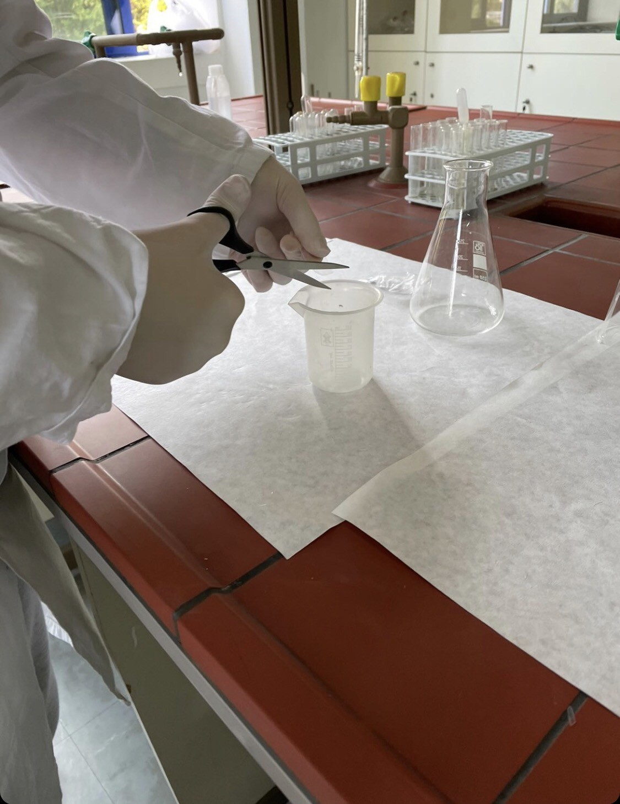
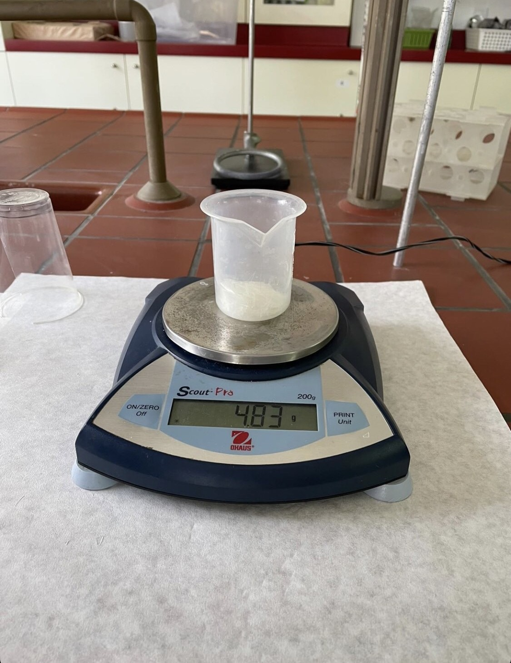
Step 1
Cut the PLA cup into small pieces using scissors. The smaller the pieces are, the faster the reaction will be.
Place the PLA pieces into a weighing boat.
Measure 5 g of PLA pieces on a digital scale.

Slide 5
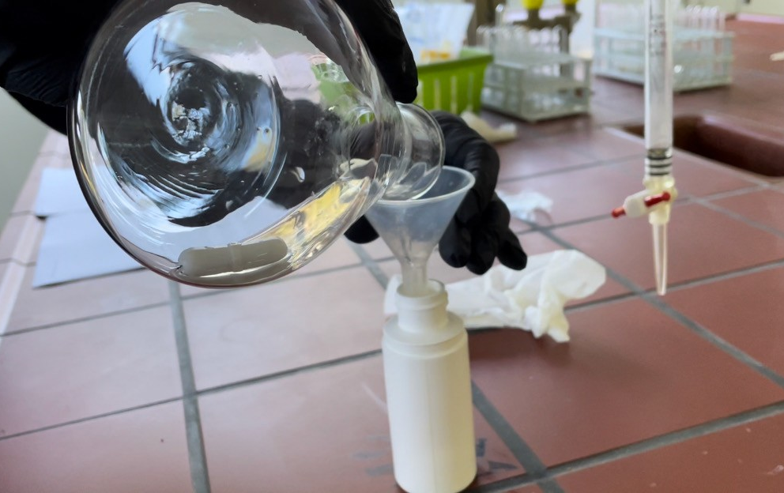
Step 1
Add 5 g of PLA pieces into the 250 mL Erlenmeyer flask using a funnel.

Slide 6
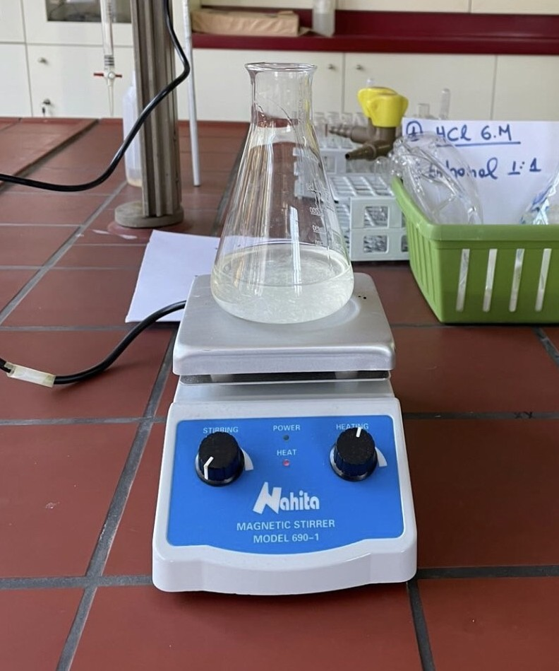
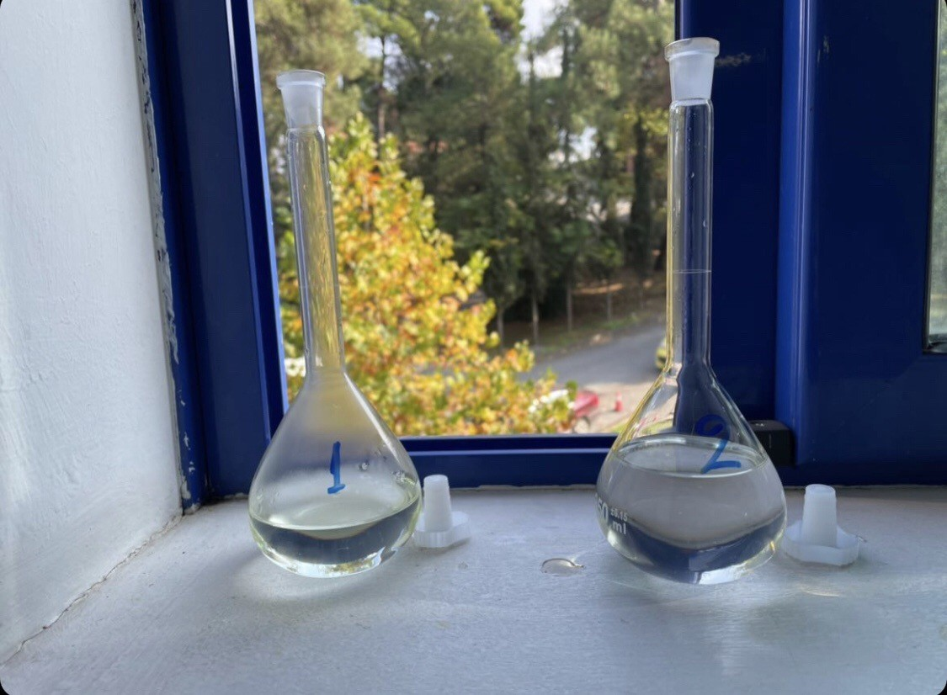
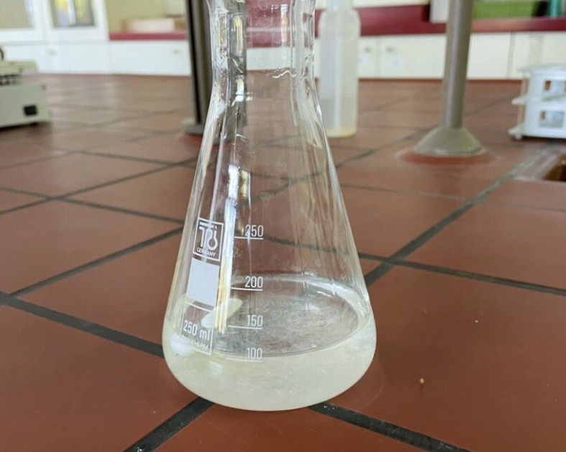
Step 1
Using the graduated cylinder, measure 100 mL of the pre-prepared solution (1.4 M NaOH in 1:1 ethanol/water).
Add the solution and 1 magnetic stirring rod into the flask.

Slide 7
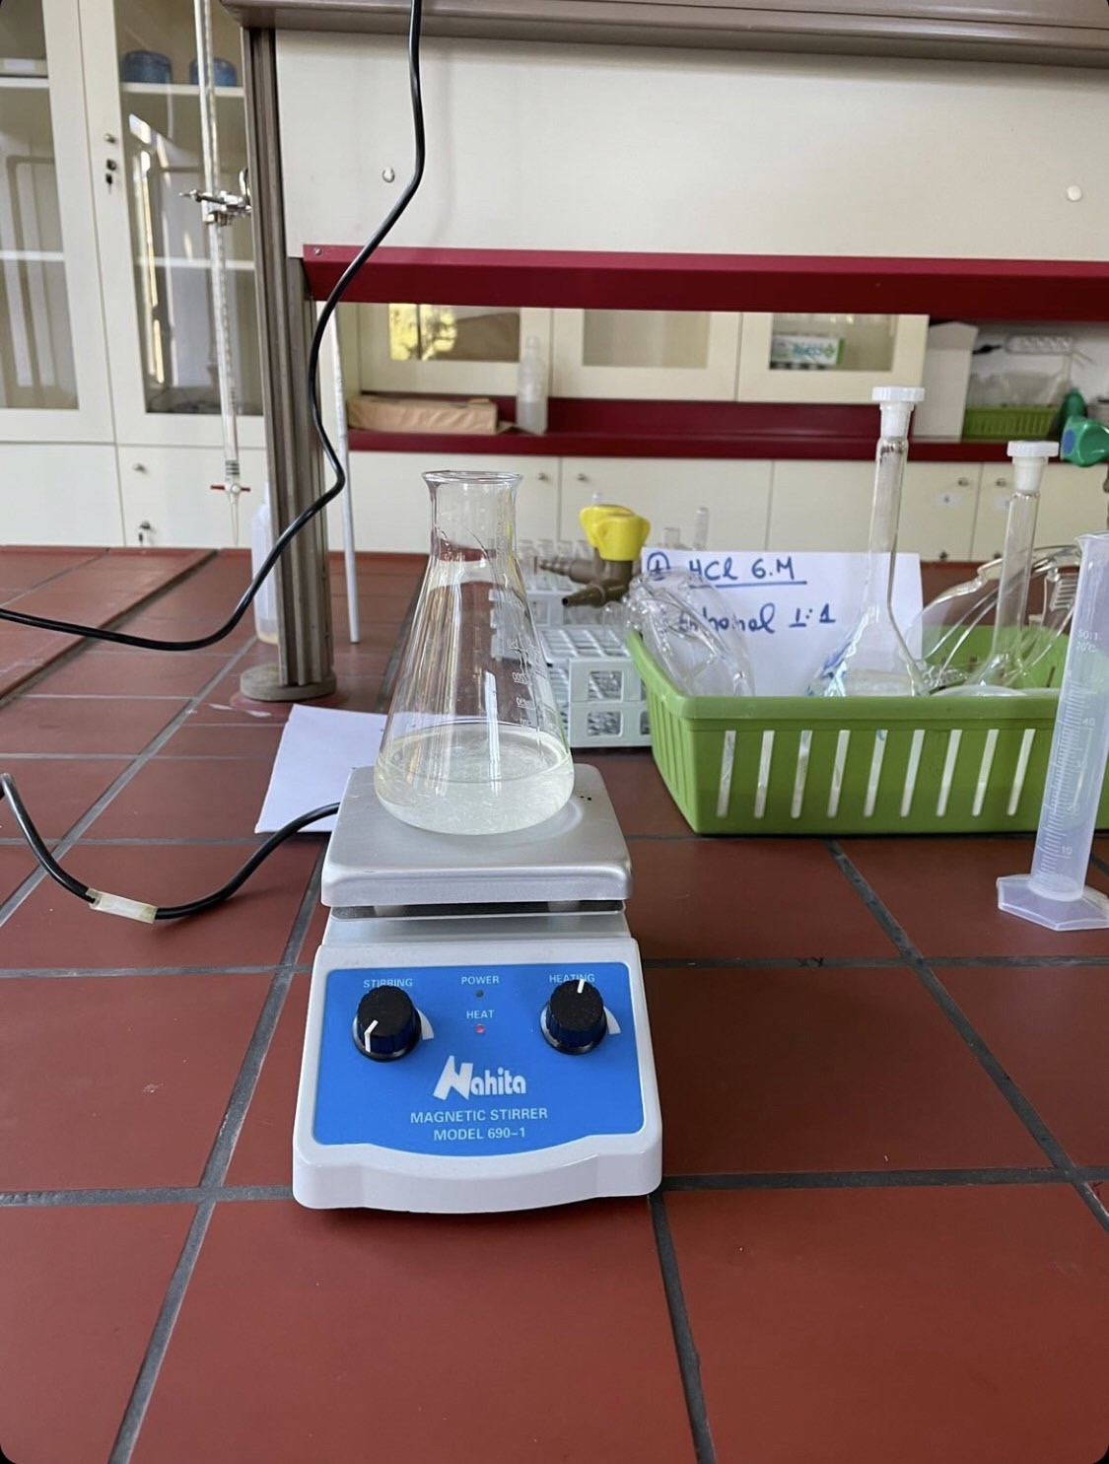
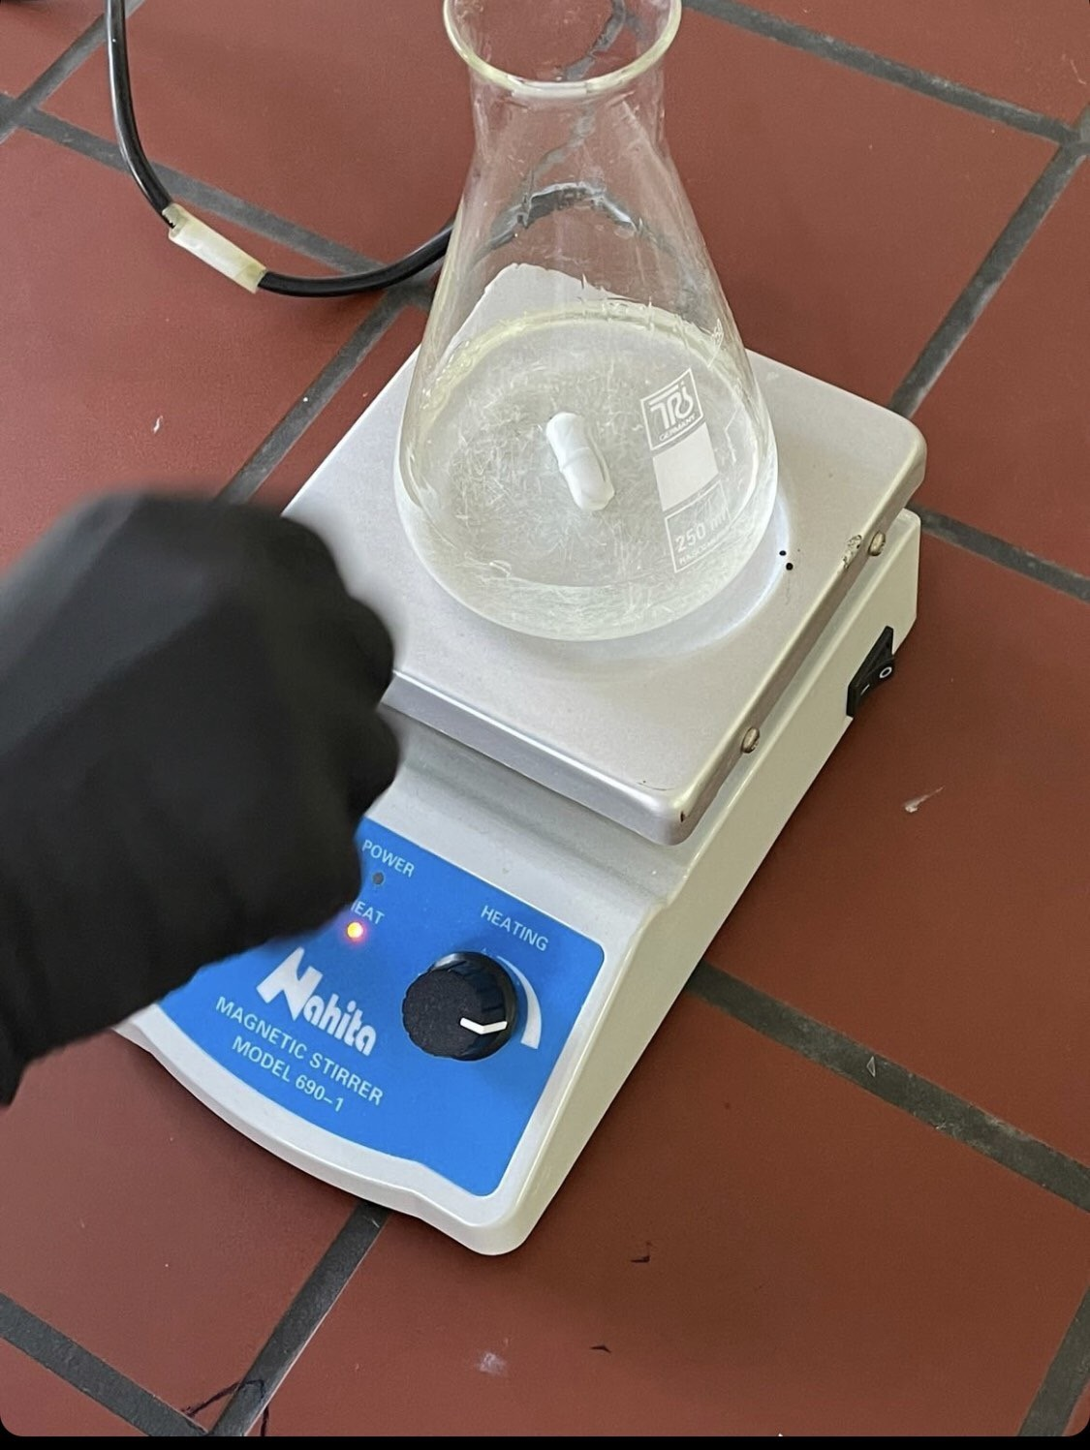
Step 1
Place the flask onto the hot plate.
Turn on the heating function of the hot plate and heat the solution to 90˚C (reduce the heat if the flask begins to boil vigorously).

Slide 8
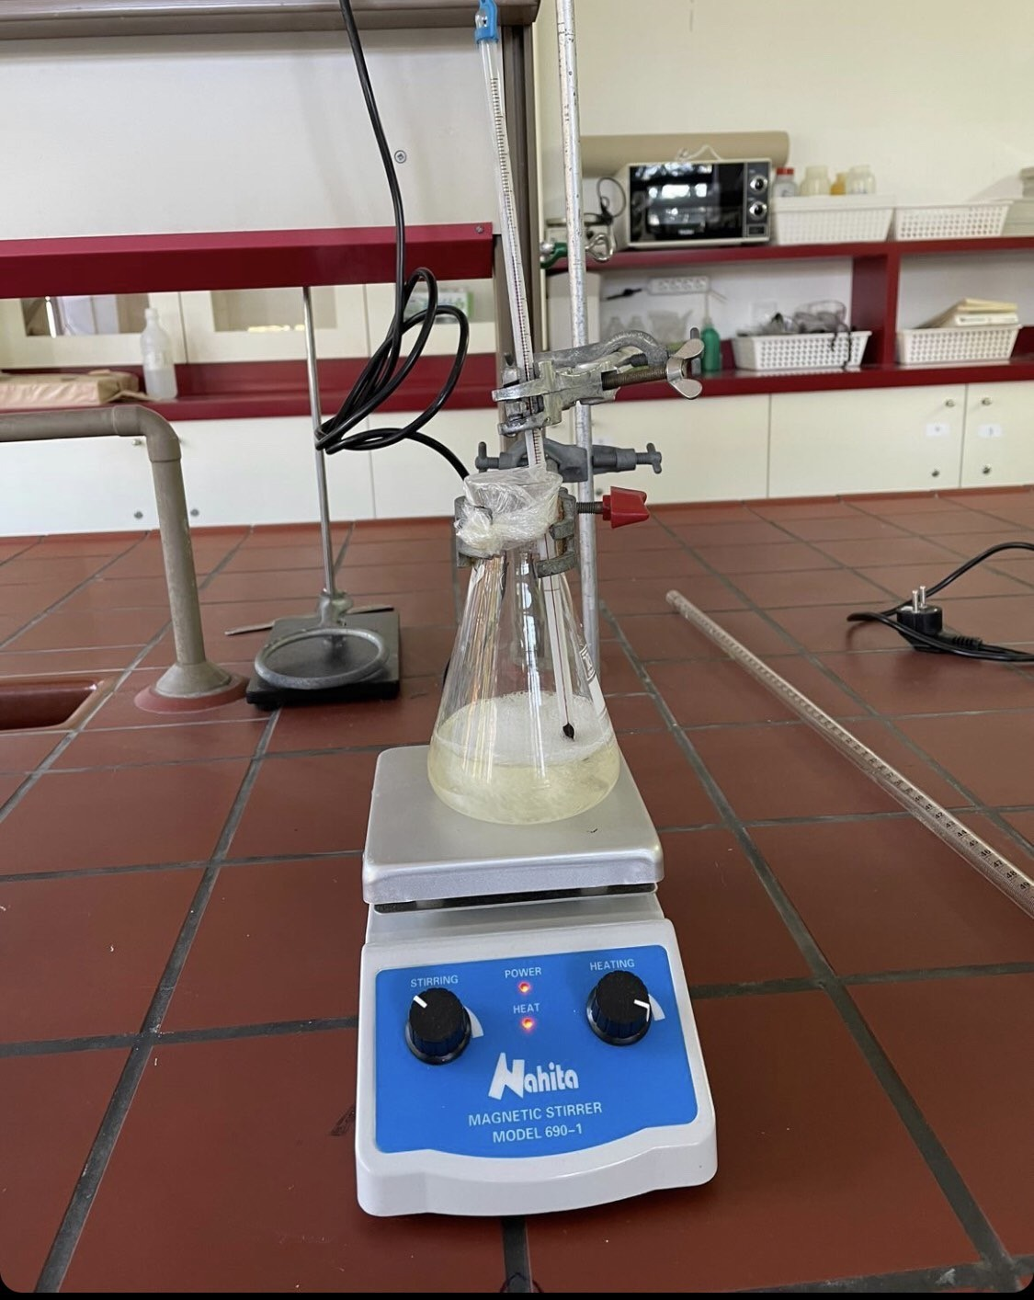
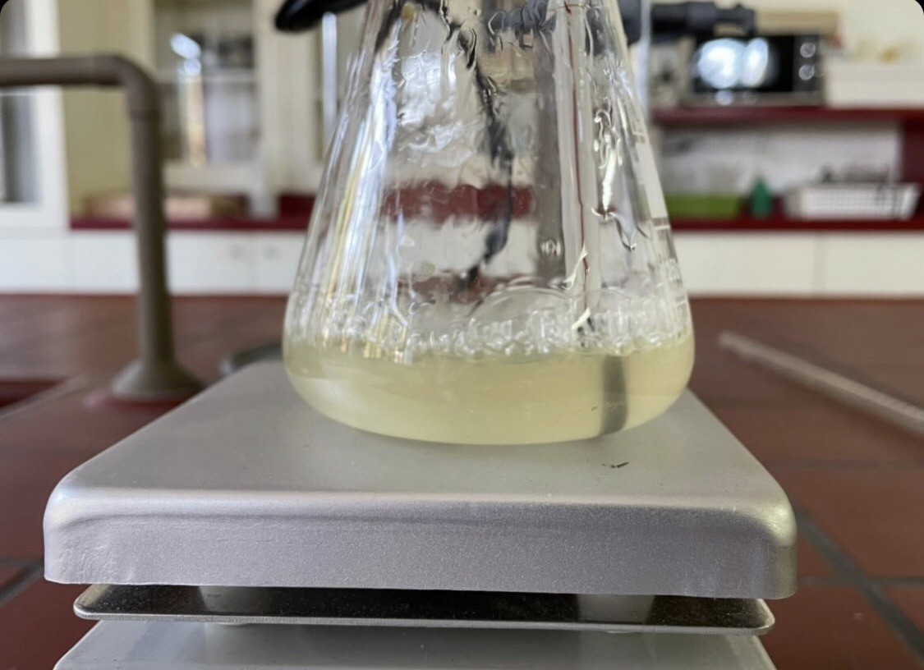
Step 1
Heat and stir the solution with a stirring rod until the PLA pieces have completely dissolved.

Slide 9
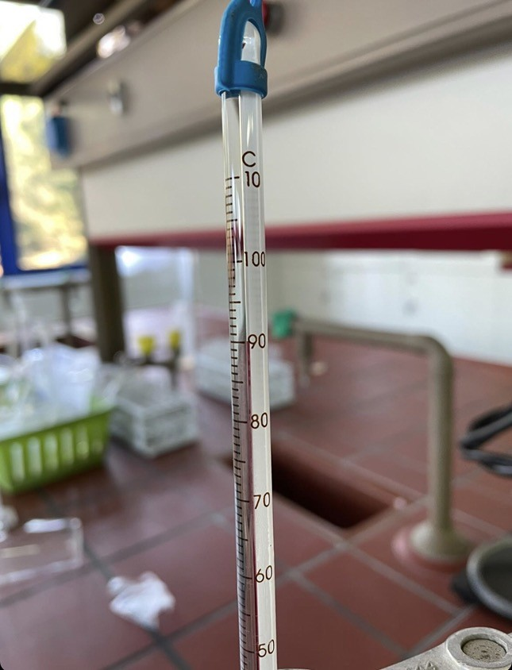
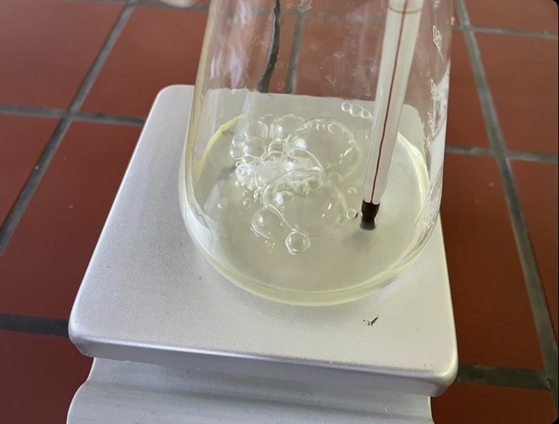
Step 1
After the PLA pieces have completely dissolved and the solution is pale yellow, turn off the hot plate. The temperature should be 80˚C – 90˚C.

Slide 10
Recycling Polylactic Acid
Experiment:
Step 2

Slide 11
Step 2
Use heat resistant gloves to remove flask from hot plate.
Place the flask in an ice water bath and allow the solution to cool until it is below 60˚C. This mixture is now called “hydrolysed PLA”.

Slide 12
Recycling Polylactic Acid
Experiment:
Step 3

Slide 13
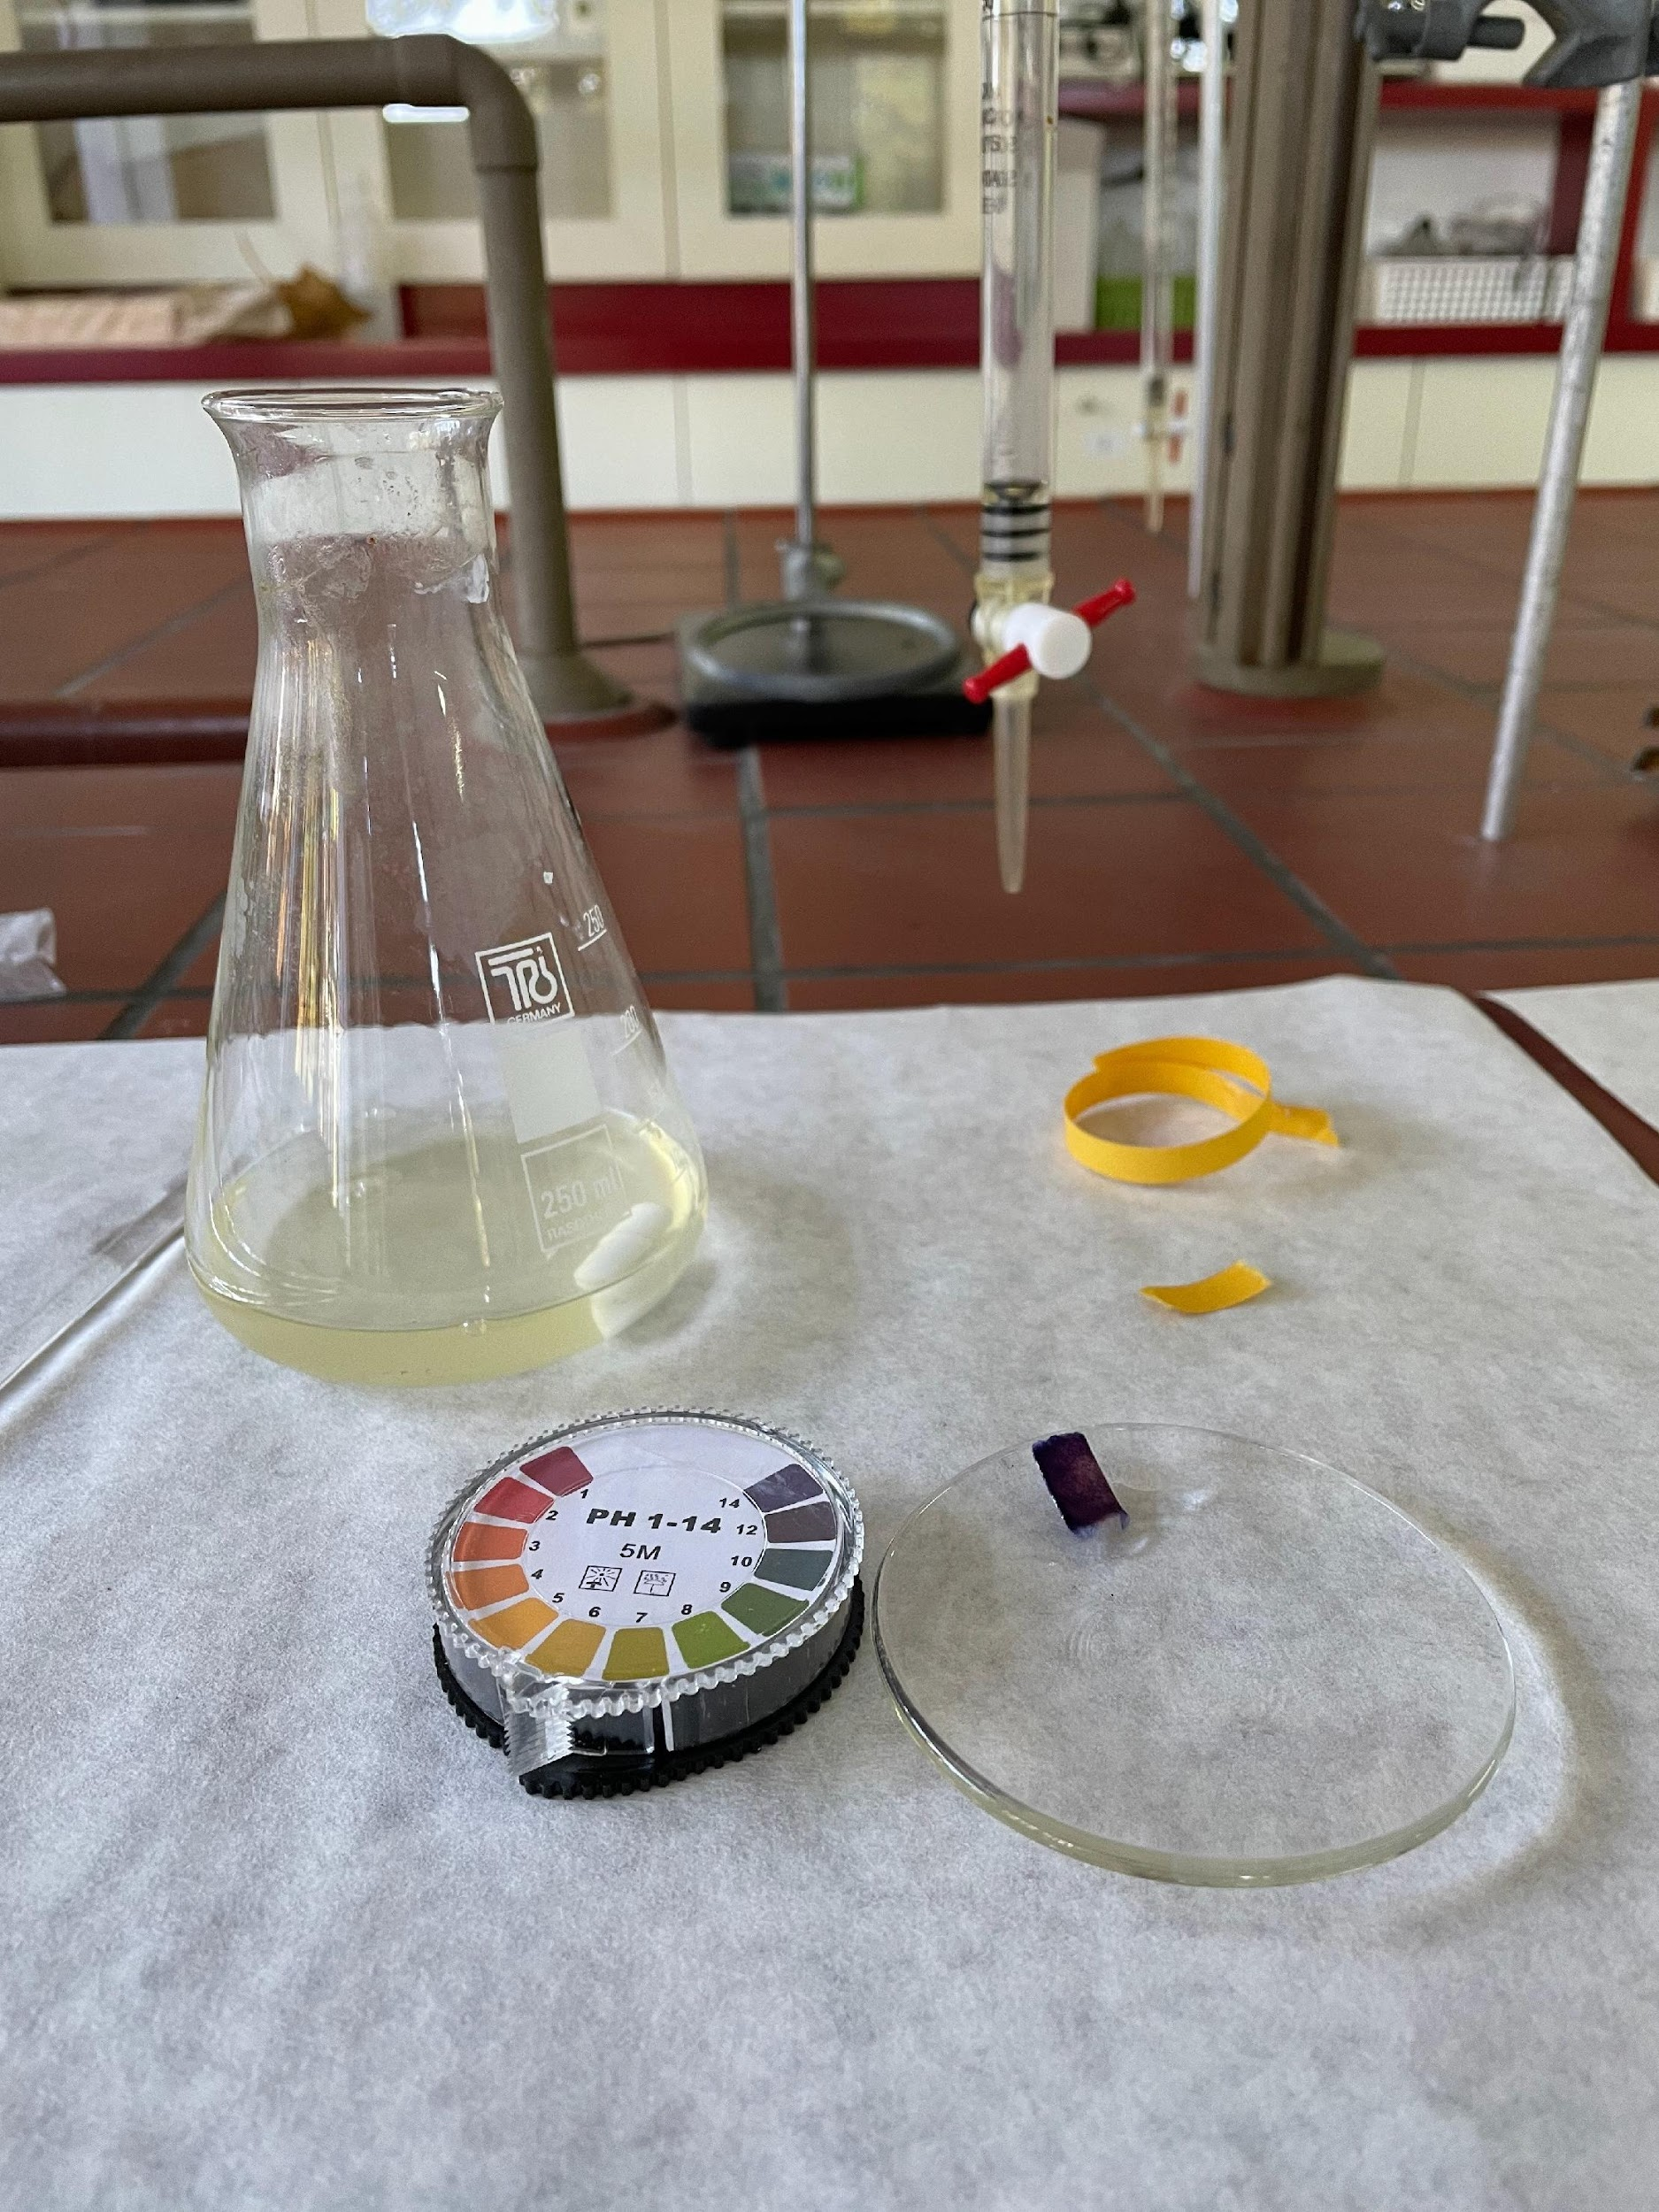
Step 3
Using the plastic pipette, transfer 1-2 drops of the solution to the watch glass.
Test the pH of the hydrolyzed PLA by dipping a pH strip in the watch glass.
This means that the pH of the solution is 14.

Slide 14
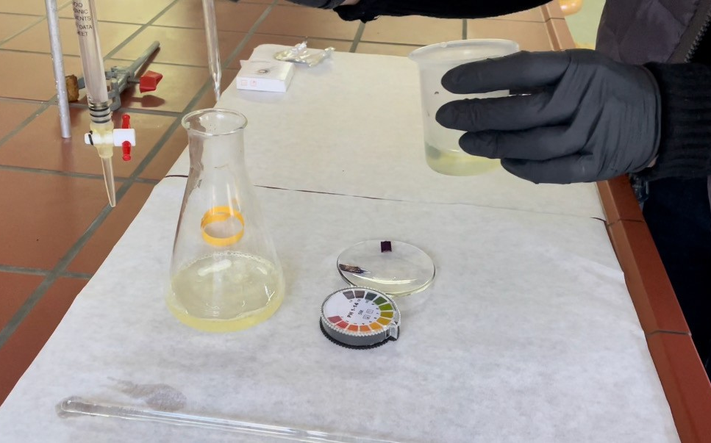
Step 3
Slowly add 200 drops of 6 M HCl into the flask and mix.

Slide 15
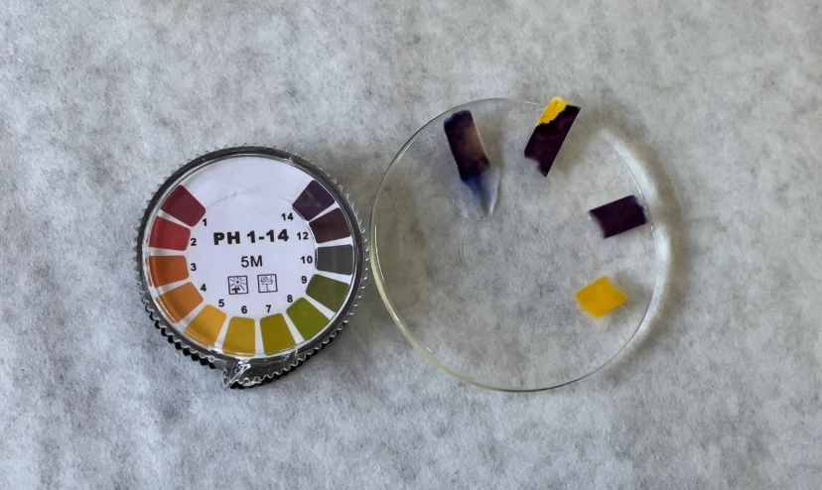
Step 3
Measure the final pH of the solution using a pH strip. Aim for a pH range of 4-5. The solution now contains lactic acid and sodium chloride (NaCl).
pH before: 14
pH after: 5

Slide 16
Step 3
Using a funnel, transfer the lactic acid solution into the plastic bottle. It is now ready to use.

