Slide 1
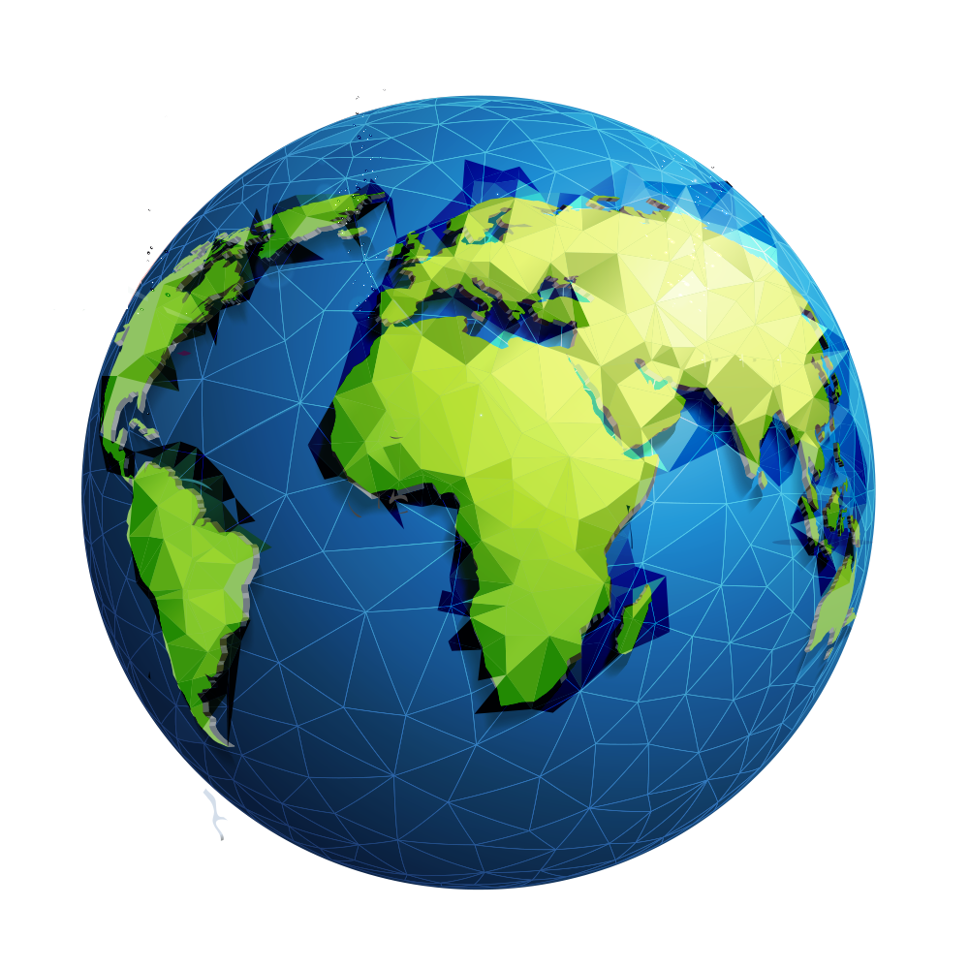
If the world…

Slide 2
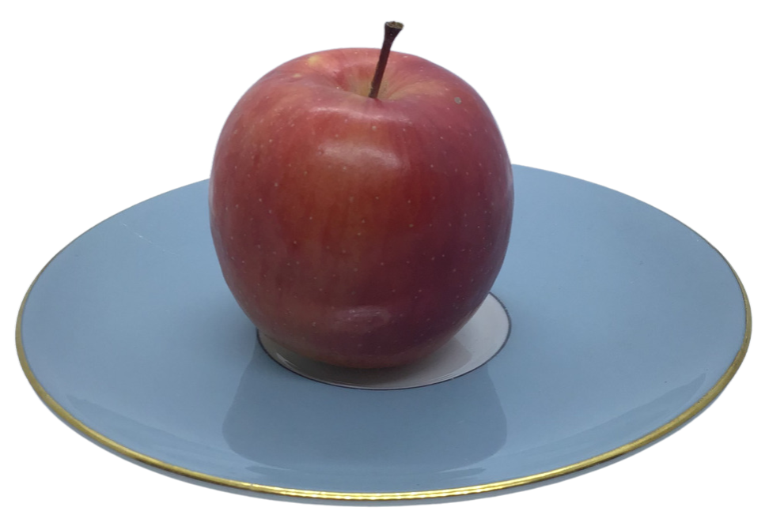
… was an apple

Slide 3
How much do you think is land? How much is water?

Slide 4
Slice the apple into 4 equal pieces.

Slide 5
¾ represent all the oceans, lakes, rivers and water on the Earth.

Slide 6
¼ represents all the land on Earth.

Slide 7
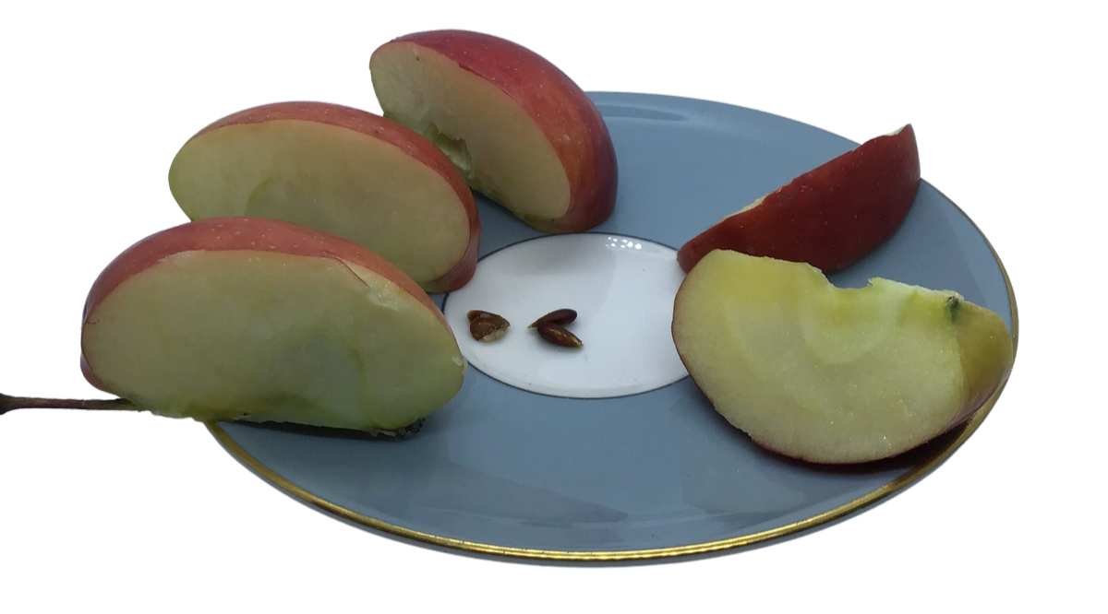
Carefully slice the quarter that represents the land into two. This means you have 2 x ⅛.

Slide 8
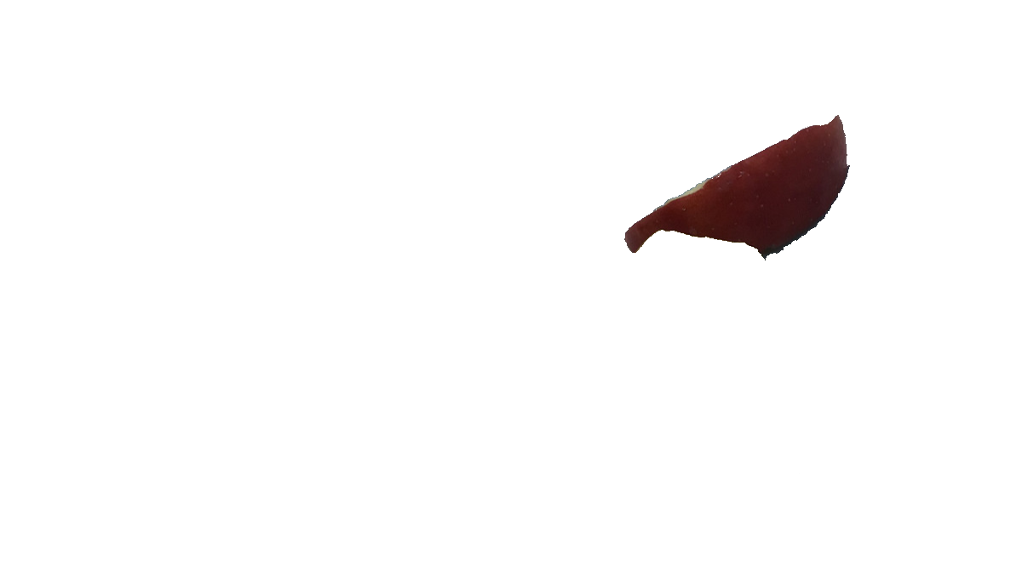
⅛ represents the ice, deserts and mountains on Earth.

Slide 9
The other ⅛ is the land that is left.

Slide 10
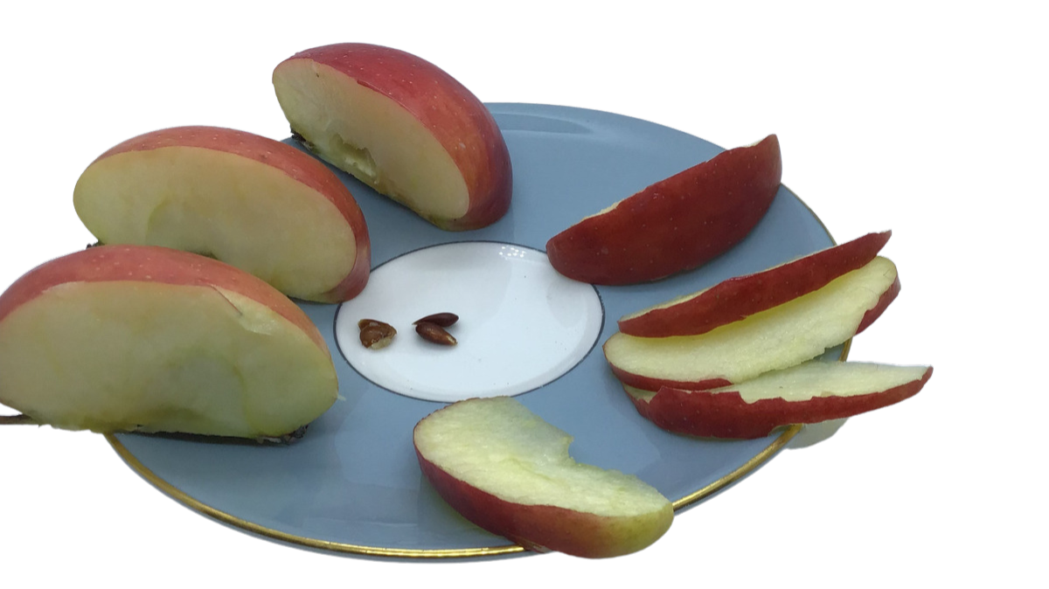
Very carefully slice the land ⅛ into four pieces – each piece is now ¹⁄₃₂.

Slide 11
3 x ¹⁄₃₂ are too wet, cold, rocky, steep, have poor soil or are underneath houses and cities so cannot grow food.

Slide 12
¹⁄₃₂ is the only land that can grow food.

Slide 13
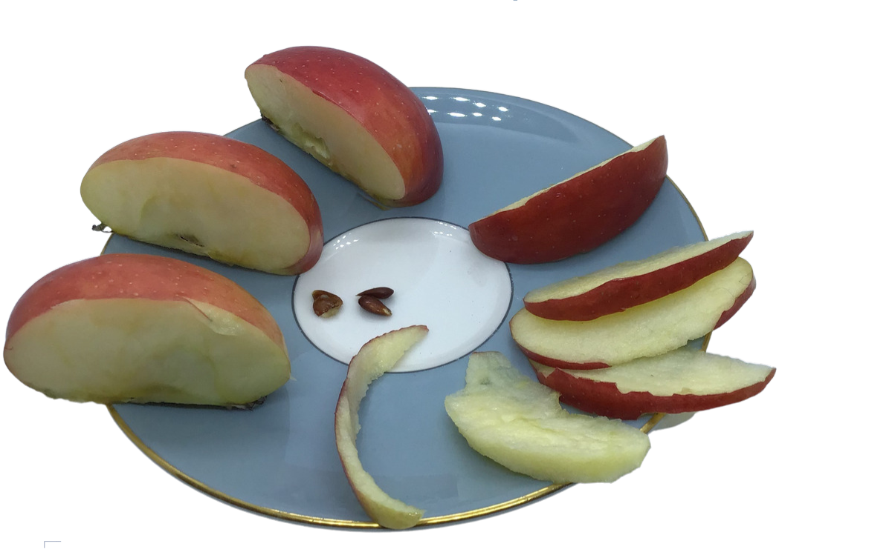
Now, peel the skin from the apple. The peel represents the surface of the Earth that can grow food.

Slide 14
Most suitable land has only 150 cm (5ft) of soil that can grow food. This will produce all the food in the world.

Slide 15
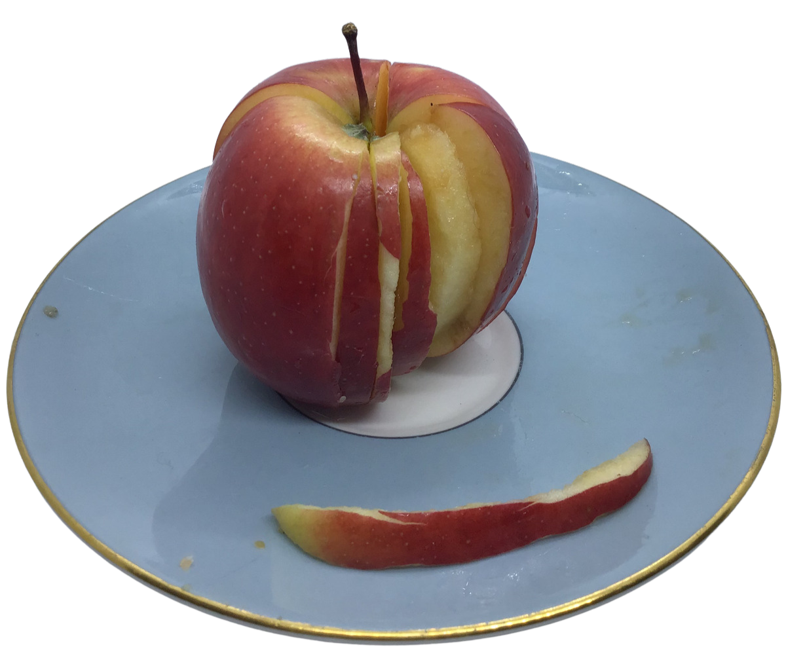
Scientists are working to try and make this land grow more food with less harmless effects on the world.

Slide 16
They are trying to develop ways to grow more food in the same area to feed an ever-growing population.

