Slide 1
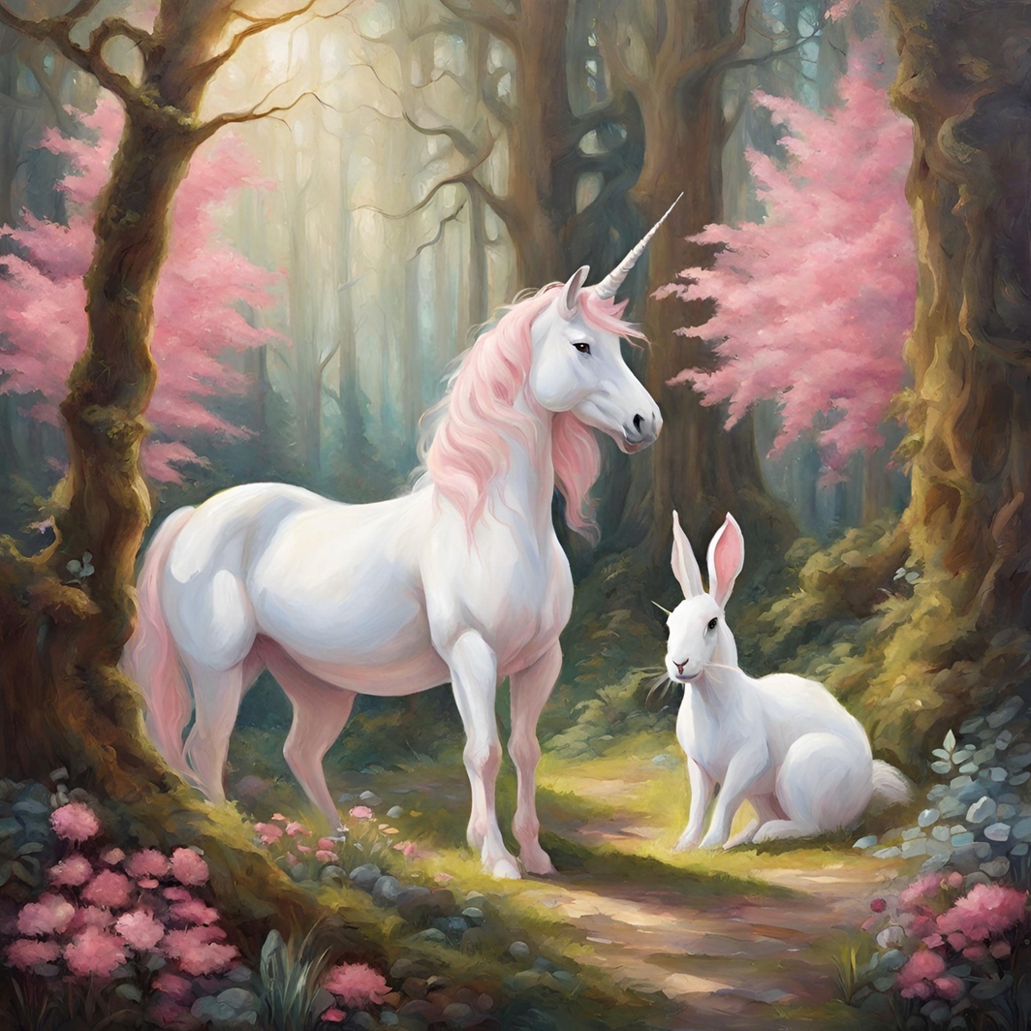
An oil painting of a white unicorn and a pink rabbit in an enchanted forest on a sunny day.
AI generated Image Examples
AI image generators, such as Canva, DALL.E and ImageFX, create unique images from text prompts.
Image generation is a generative form of AI - they are deep-learning models that are trained on huge amounts of raw data —and “learn” to generate realistic outputs when prompted.
Image created by Canva AI Image Generator

Slide 2
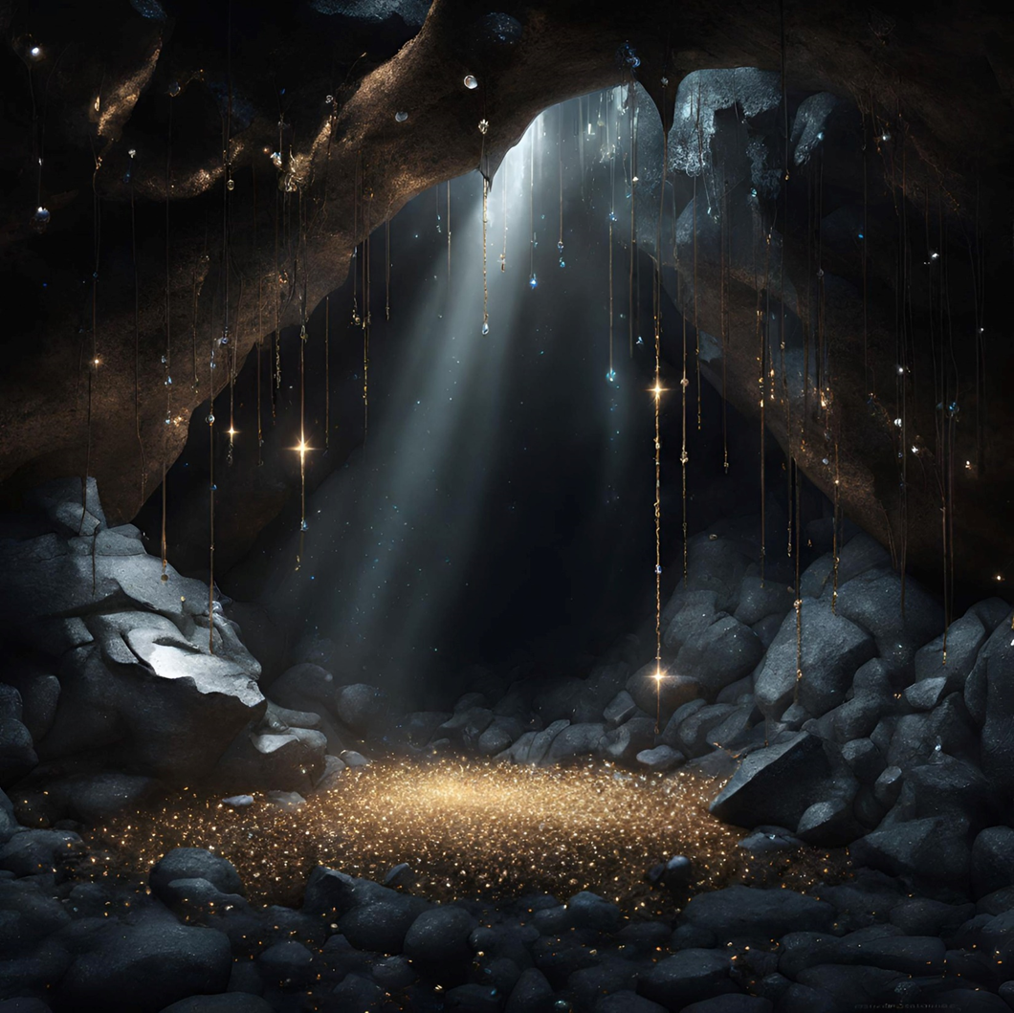
A photo of a dark cave filled with glittering jewels lit by a single shaft of light from a crack in the roof.
AI generated Image Examples
The more specific you can be with your prompts the closer the images will be to what you want.
Image created by Canva AI Image Generator

Slide 3
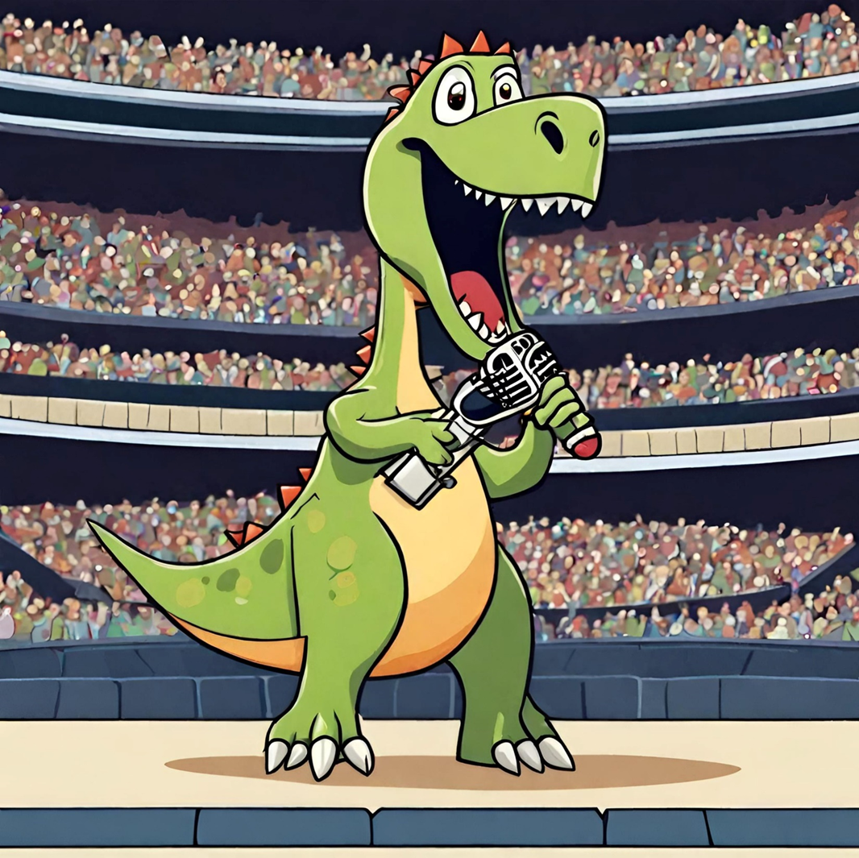
A green cartoon dinosaur singing in a concert in a stadium.
AI generated Image Examples
You can specify the style of image that you want, anything from a realistic photo to a cartoon, an oil painting to Anime.
Image created by DALL.E 2 AI Image Generator

Slide 4
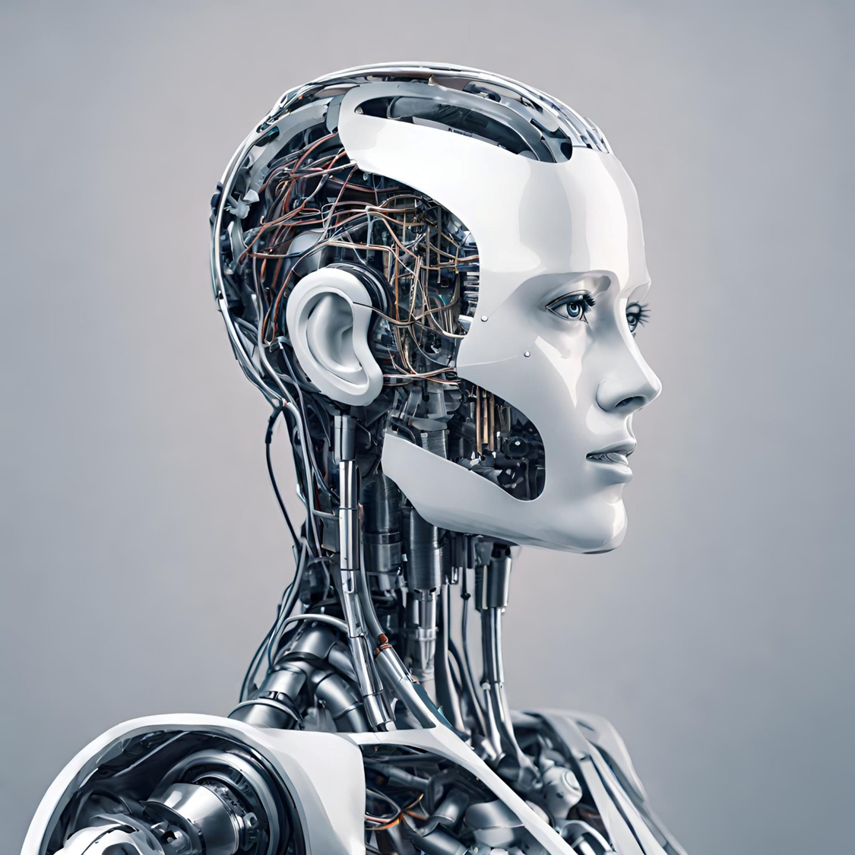
A photo of an AI robot.
AI generated Image Examples
Image created by DALL.E 1 AI Image Generator

Slide 5
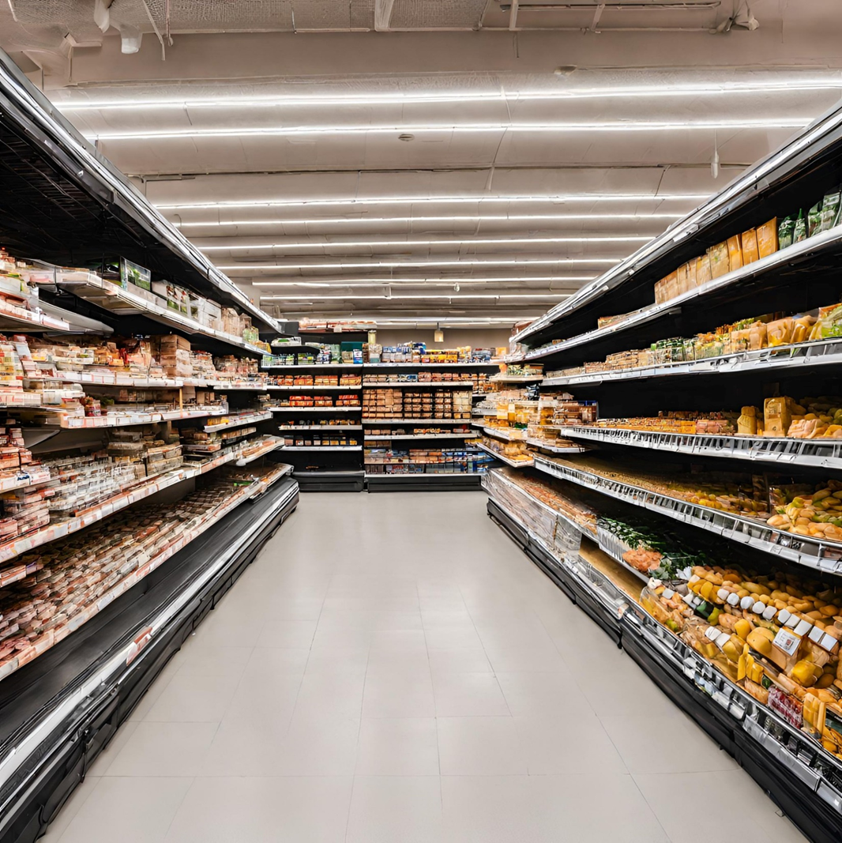
A photo of an empty supermarket with well stocked shelves.
AI generated Image Examples
Image created by Canva AI Image Generator

Slide 6
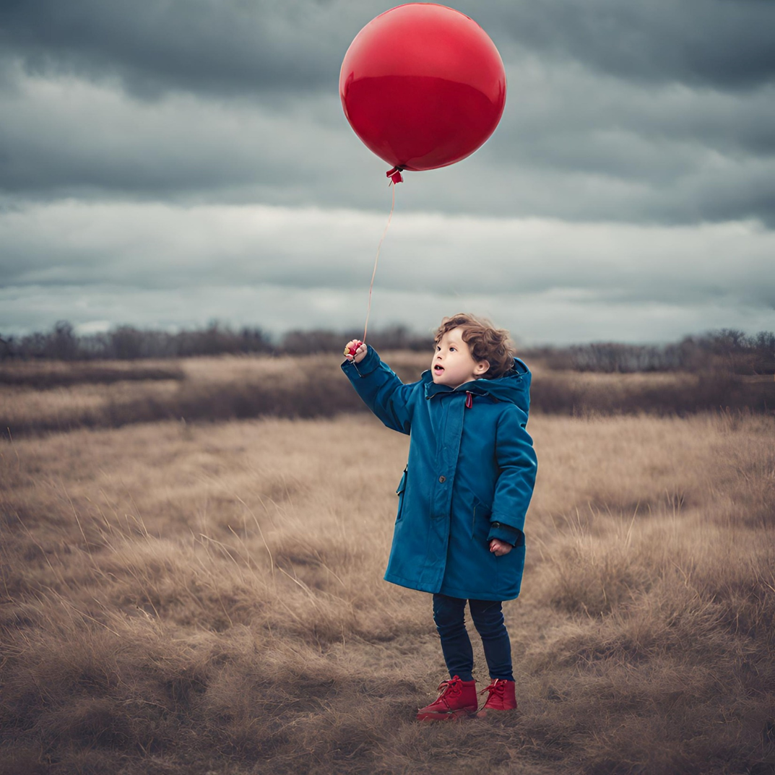
A photo of a small boy in a blue coat holding a red balloon.
AI generated Image Examples
AI finds aspects of a human very difficult to get right. In this case, if you zoom in, the face isn’t very well defined.
AI learns though and improves each time it is used, the latest versions of image generators is a huge improvement on the pervious versions.
Image created by Canva AI Image Generator

Slide 7
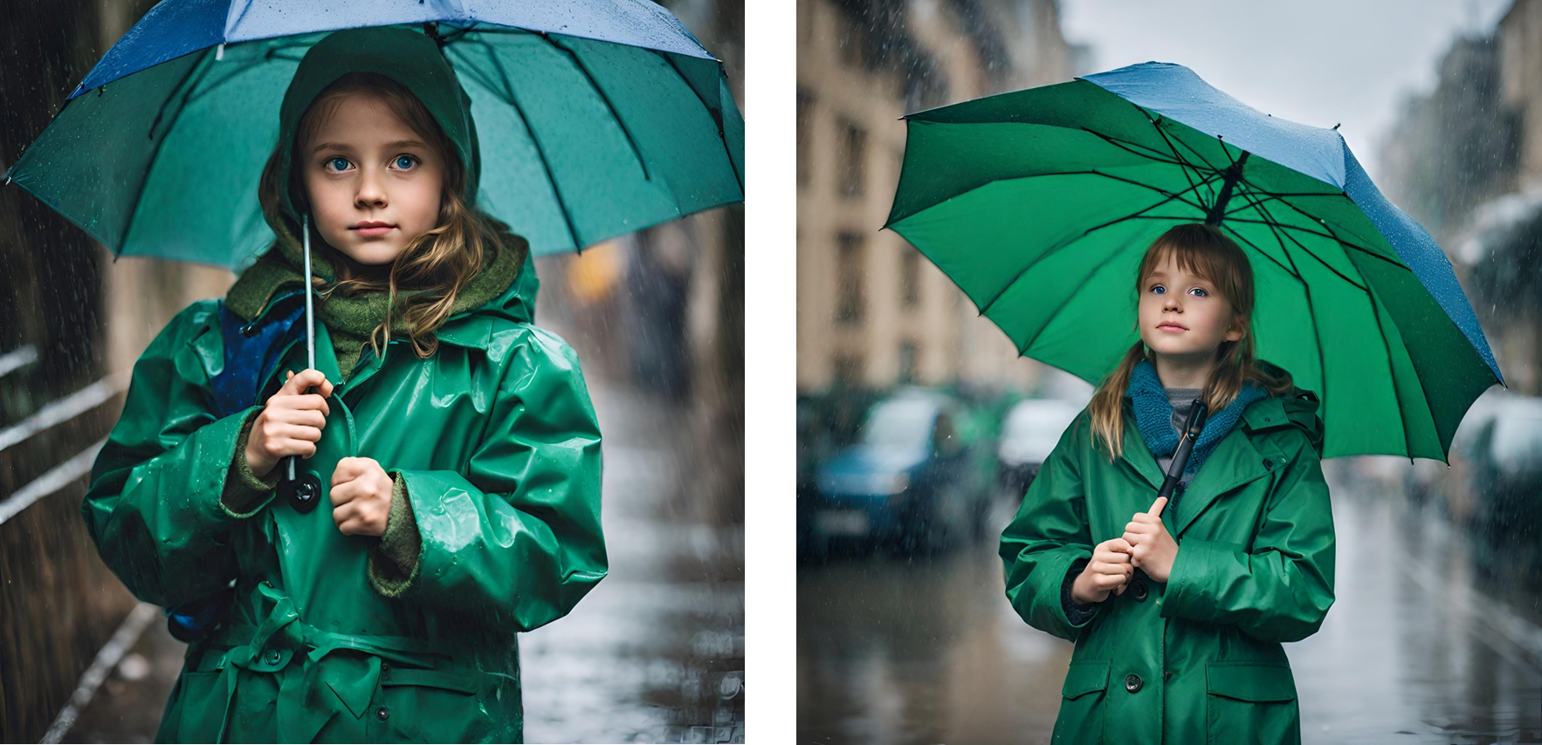
A photo of a young girl in a green coat holding a blue umbrella on a rainy day.
AI generated Image Examples
From a distance these look really good, but if you zoom in on the hands and eyes you’ll see that AI still finds those aspects of a human difficult. It is improving though and will continue to improve the more it is used.
Images created by Canva AI Image Generator

