Slide 1
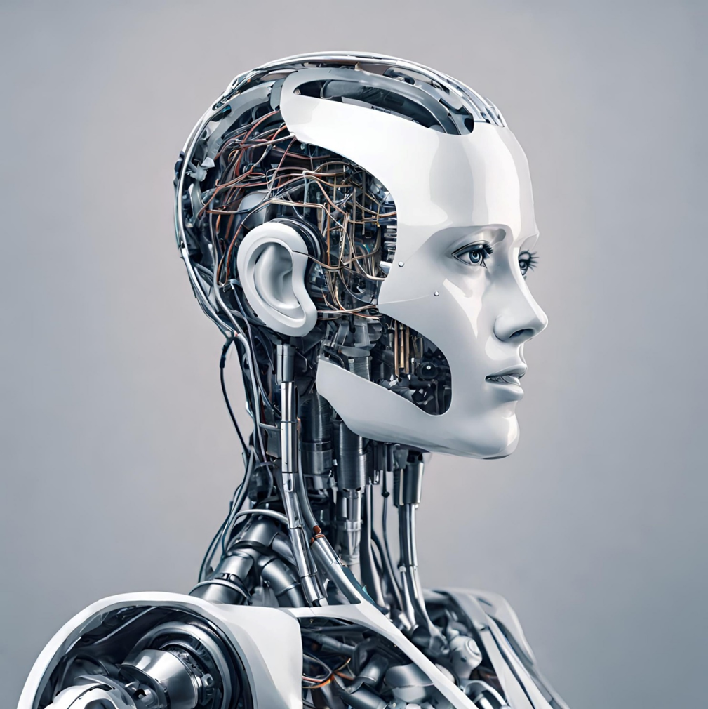
First Steps in AI and Data Analysis
Lesson 1
Image created by Dall.E

Slide 2
First Steps in AI and Data Analysis
Lesson 1
What do you think Artificial Intelligence and Machine Learning are?
What do you know about Artificial Intelligence and Machine Learning?

Slide 3
First Steps in AI and Data Analysis
Lesson 1
Imagine a robot that can play chess like a grandmaster, translate languages in real-time, or even write you a funny story. That's kind of what Artificial Intelligence (AI) is!
It's like giving machines a super-charged brain that lets them learn and do things we usually think only humans can. AI is still being figured out, but it's already helping us with healthcare, making our phones smarter, and even designing new inventions.
So next time you see a robot vacuuming or hear a song composed by AI, remember, that's the power of super-smart machines at work!
Definition of Artificial Intelligence written by Google Bard

Slide 4
First Steps in AI and Data Analysis
Lesson 1
Artificial Intelligence, or AI, is like giving computers the ability to think and learn on their own.
It's a smart technology that helps machines understand, solve problems, and make decisions, similar to how humans do.
AI is used in things like games, virtual assistants, and even helping with important tasks!
Definition of Artificial Intelligence written by ChatGPT 3.5

Slide 5
First Steps in AI and Data Analysis
Lesson 1
Imagine teaching a robot by showing it examples, like pictures of cats and dogs. Machine learning is like that, but for computers!
They learn from tons of data, like music or words, and get better at things like identifying things or predicting what you might like.
It's like giving a computer superpowers to become the ultimate learner!
Definition of Machine Learning written by Google Bard

Slide 6
First Steps in AI and Data Analysis
Lesson 1
Machine learning is like teaching computers to learn from examples and make decisions without being explicitly programmed.
It's like training a robot dog – the more tricks you show it, the better it gets at doing new tricks on its own.
Definition of Machine Learning written by ChatGPT 3.5

Slide 7
First Steps in AI and Data Analysis
Lesson 1
How do you think AI and Machine Learning already affect your lives?

Slide 8
First Steps in AI and Data Analysis
Lesson 1
How do you think AI and Machine Learning already affect your lives?
Smart Speakers/Digital Assistants; Alexa, Google Nest, Siri
Social Media algorithms
Smart TV suggestions
Music player suggestions
Store Cards
Online Shopping
Biometric Security
Google Maps
Google Translate
Predictive Text
Photo Editing
Video Games
Chatbots

Slide 9
Lesson 2

Slide 10
First Steps in AI and Data Analysis
Lesson 2
What can you tell about these people’s lives from their till receipts?
What are the similarities and differences in their circumstances?

Slide 11
First Steps in AI and Data Analysis
Lesson 2
What do you think supermarkets do with all the information from shoppers’ loyalty cards?
Why might using a loyalty card benefit both the supermarket and the shopper?

Slide 12
First Steps in AI and Data Analysis
Lesson 3

Slide 13
First Steps in AI and Data Analysis
Lesson 3
Insert your student‘s data
The spreadsheet will automatically plot the graph of the results.
The spreadsheet will automatically do all the calculations.

Slide 14
First Steps in AI and Data Analysis
Lesson 3
Example of real data from a class of students.

Slide 15
First Steps in AI and Data Analysis
Lesson 3
Spreadsheets do not use AI or ML, but they are excellent examples of how computer programmes can handle large amounts of data much better than humans can.

Slide 16
First Steps in AI and Data Analysis
Lesson 3
MET Office data and computing power:
The MET Office collects 250 billion bits of data every day.
The CRAY Supercomputer is capable of performing 14,000 trillion calculations per second!
© British Crown Copyright, Met Office

