Slide 1
A thought experiment: detecting quantum bombs The Elitzur-Vaidman bomb tester
Jörg Thorwart

Slide 2
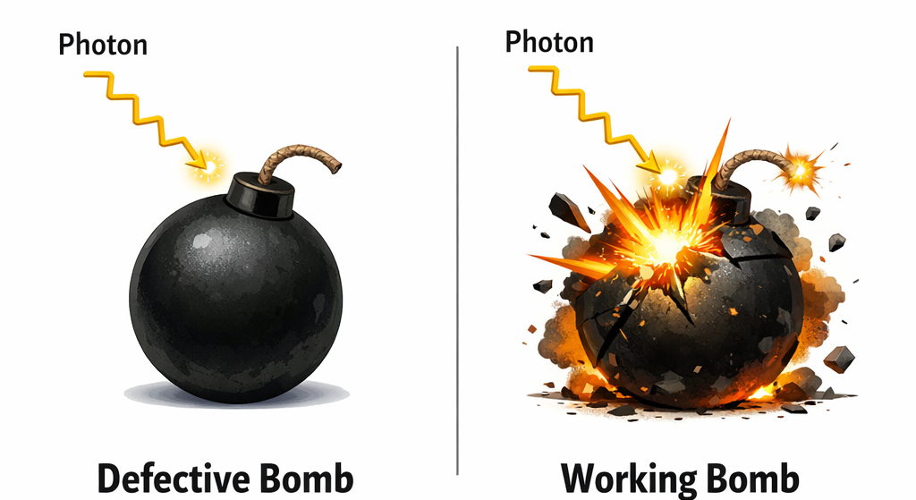
Task: Identify whether a bomb is defective or working
Think of a batch of light-sensitive bombs: some of them are working and will explode when hit by a photon, while others are defective and will not explode.
Can you identify some of the working bombs without causing them to explode?
Classically, that is not possible. But with quantum physics, it is!

Slide 3
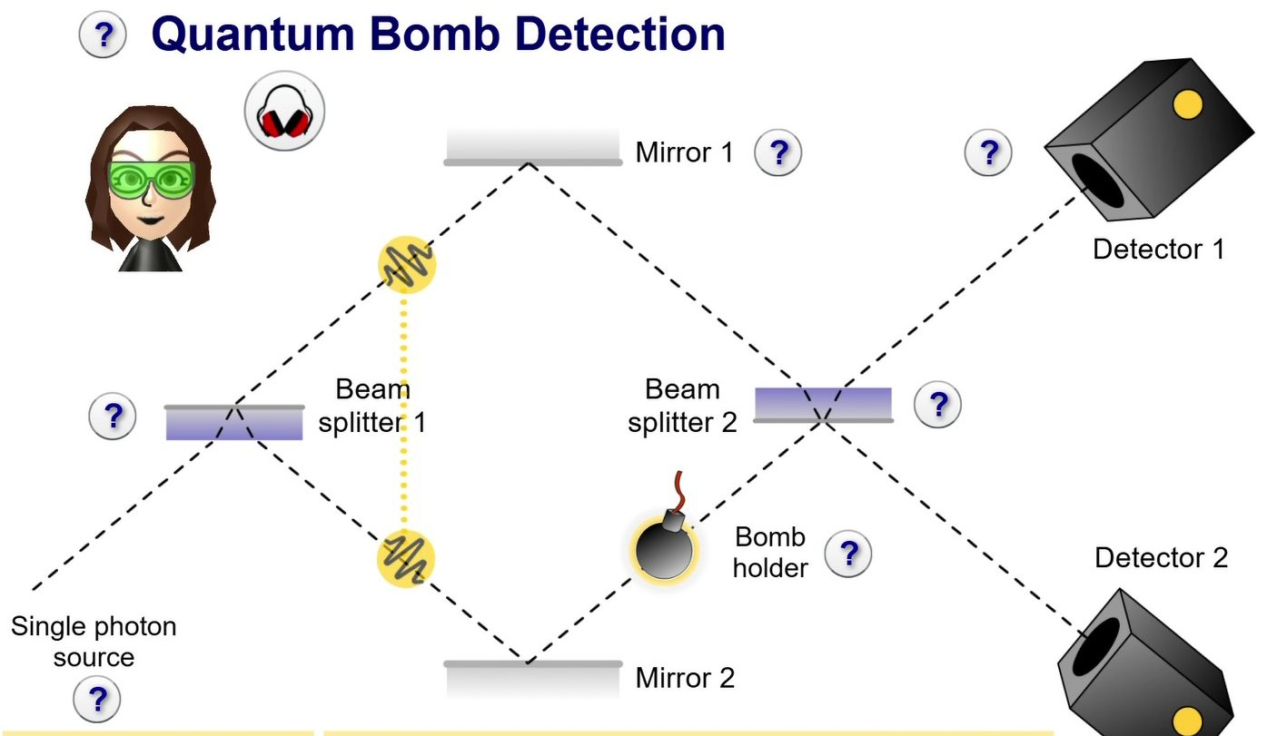
With quantum physics we can do better!
Place the bomb to be tested in the path of a Mach-Zehnder interferometer and „fire“ a single photon.

Slide 4
What happens when the bomb is defective?
When hit by a photon, a defective bomb does not explode.
The photon stays in a superposition state since it is not influenced by the bomb.
Because of interference after beam splitter 2, it reaches detector 1.

Slide 5
What happens when the bomb is working?

Slide 6
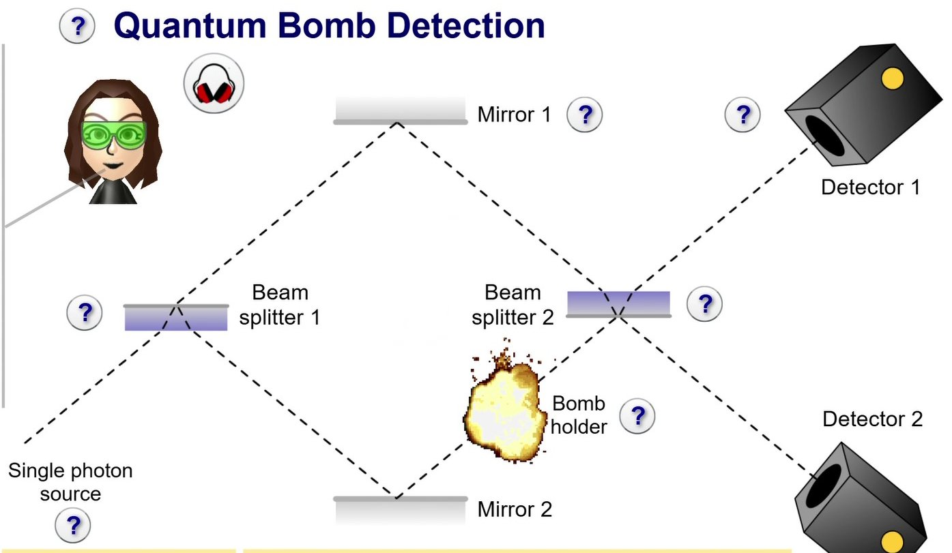
What happens when the bomb is working?
50% of all photons will make the bomb explode.
The other 50% reach the two detectors. Half of those photons (i.e. 25% of all photons) reach detector 1, the other half (25%) reach detector 2.
Explain why.

Slide 7
What happens when the bomb is working?
When the bomb explodes, this is equivalent to per- forming a measurement. The measurement destroys the superposition state of the photon.
If the bomb explodes, we definitely know that the photon took the path the bomb was in, i.e. it took the lower path.

Slide 8
What happens when the bomb is working?
So, with a probability of 50%, the photon takes the lower path and the bomb will explode.
And similarly, with a probability of 50%, the photon takes the upper path and the bomb will not explode.

Slide 9
What happens when the bomb is working?
SUMMARY
There is a 50% probability that the bomb will explode.
If the bomb explodes, we definitely know that the photon took the lower path.
This is equivalent to measuring “Which path did the photon take?”.

Slide 10
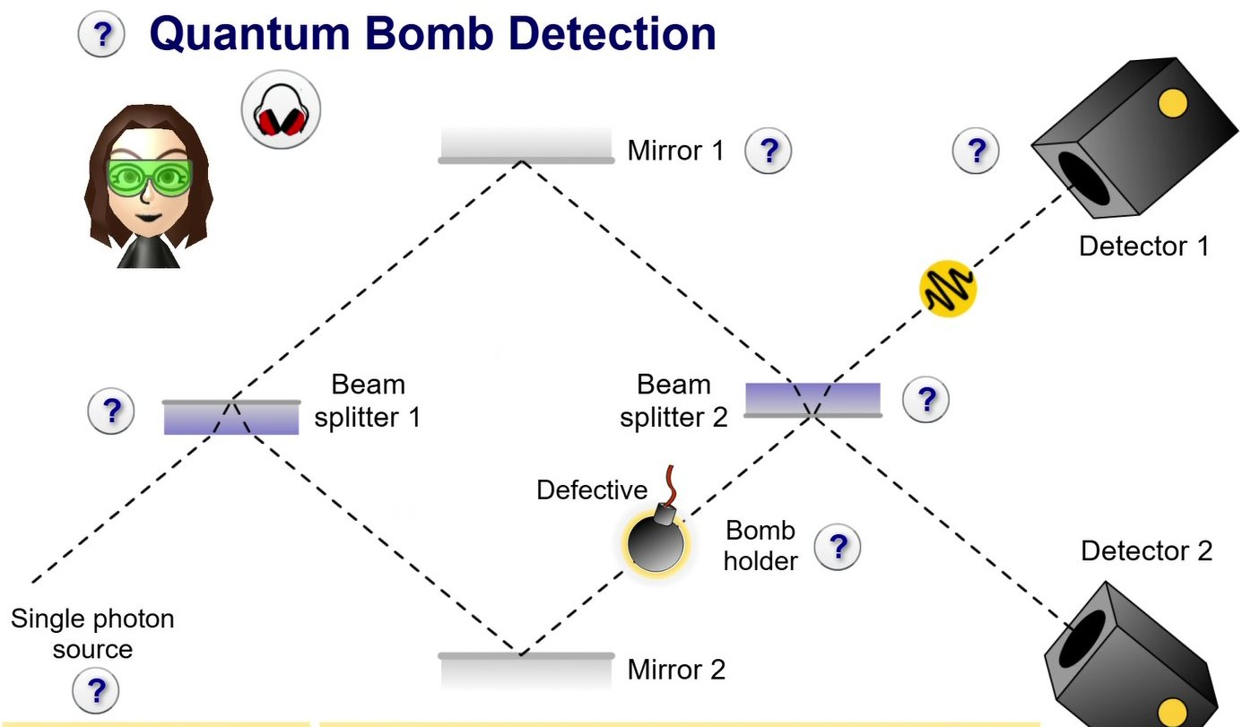
The bomb does not have to explode…
Let’s assume the photon took the upper path: it is in the state |up⟩.
The bomb does not explode and the photon reaches beam splitter 2, where a new superposition state is created.
There is a 50% probability that the photon reaches detector 1, and likewise, a 50% probability that it reaches detector 2.

Slide 11
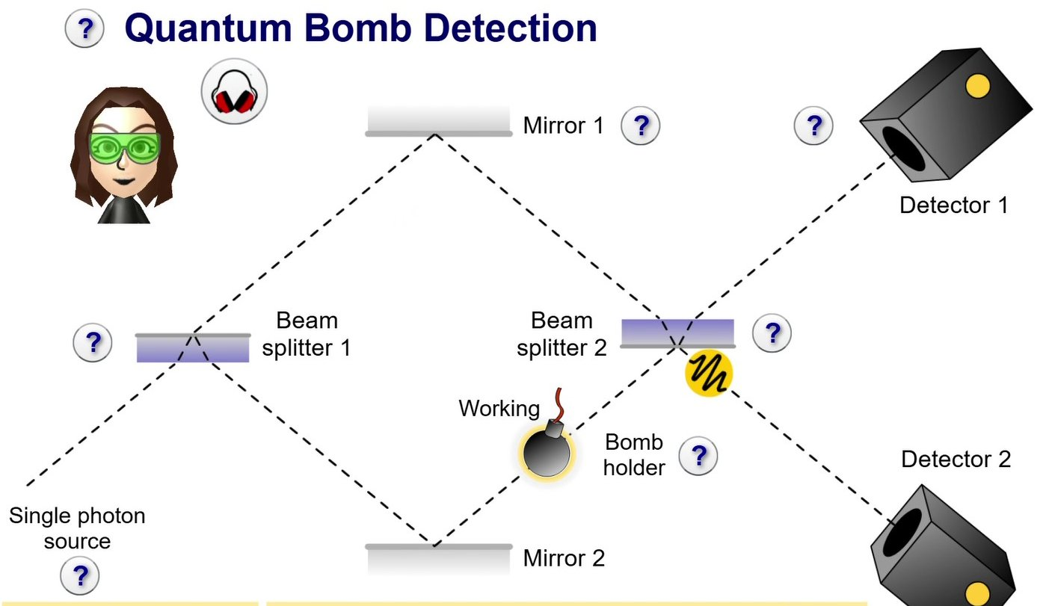
… for it to be identified as a working bomb
Observing the photon in detector 2 is only possible if the bomb is working. Hence, if the photon is detected in detector 2, we know for sure that the bomb is working – even if it didn’t explode.
This would not have been possible in classical physics!

Slide 12
Can we also identify defective bombs?
A single photon reaching detector 1 does not rule out that the bomb is working: there is still a 25% chance that the bomb is working.
When repeating this “measurement” and constantly obtaining the same result (the bomb does not explode and the photon reaches detector 1), the probability that the bomb is working gets lower with every “measurement”.
The probability that the bomb is working will get lower and lower, but it will never be zero. That is due to the probabilistic aspect of a measurement in quantum physics.

Slide 13

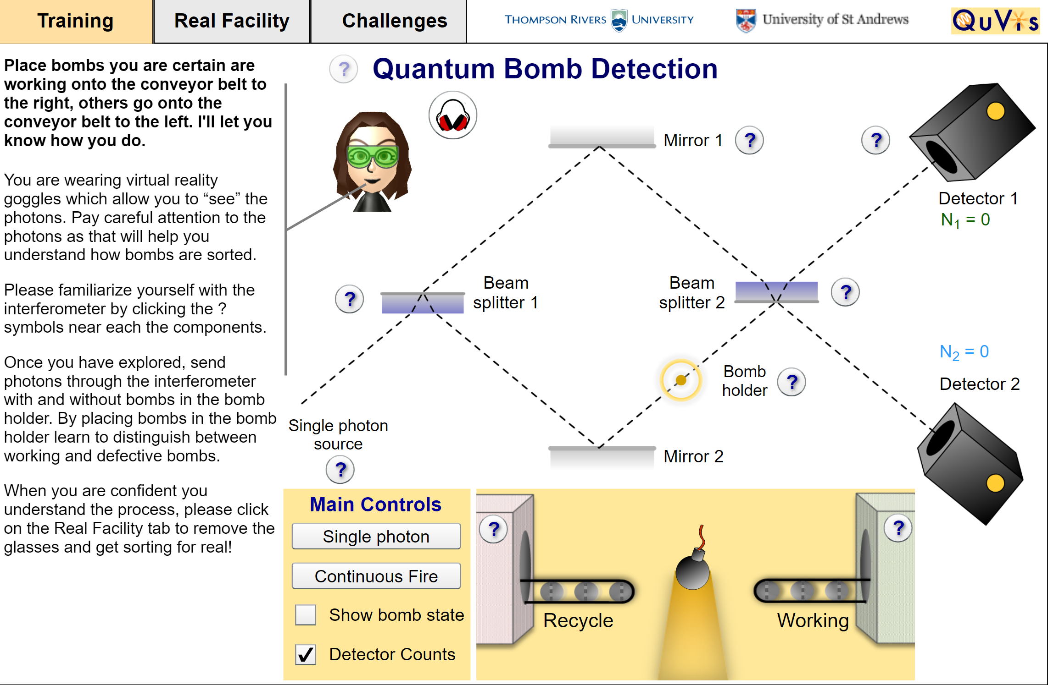
Use and test your knowledge!
Use the „Quantum Bomb Detection“ animation of St. Andrews University (UK).
Detect 10 bombs in a „Real Facility“.
Answer the questions about quantum bomb detection by clicking on the tab „Challenges“.

