Slide 1
Basics of quantum physics
12 June 2025
Aleksandr Sorokin

Slide 2
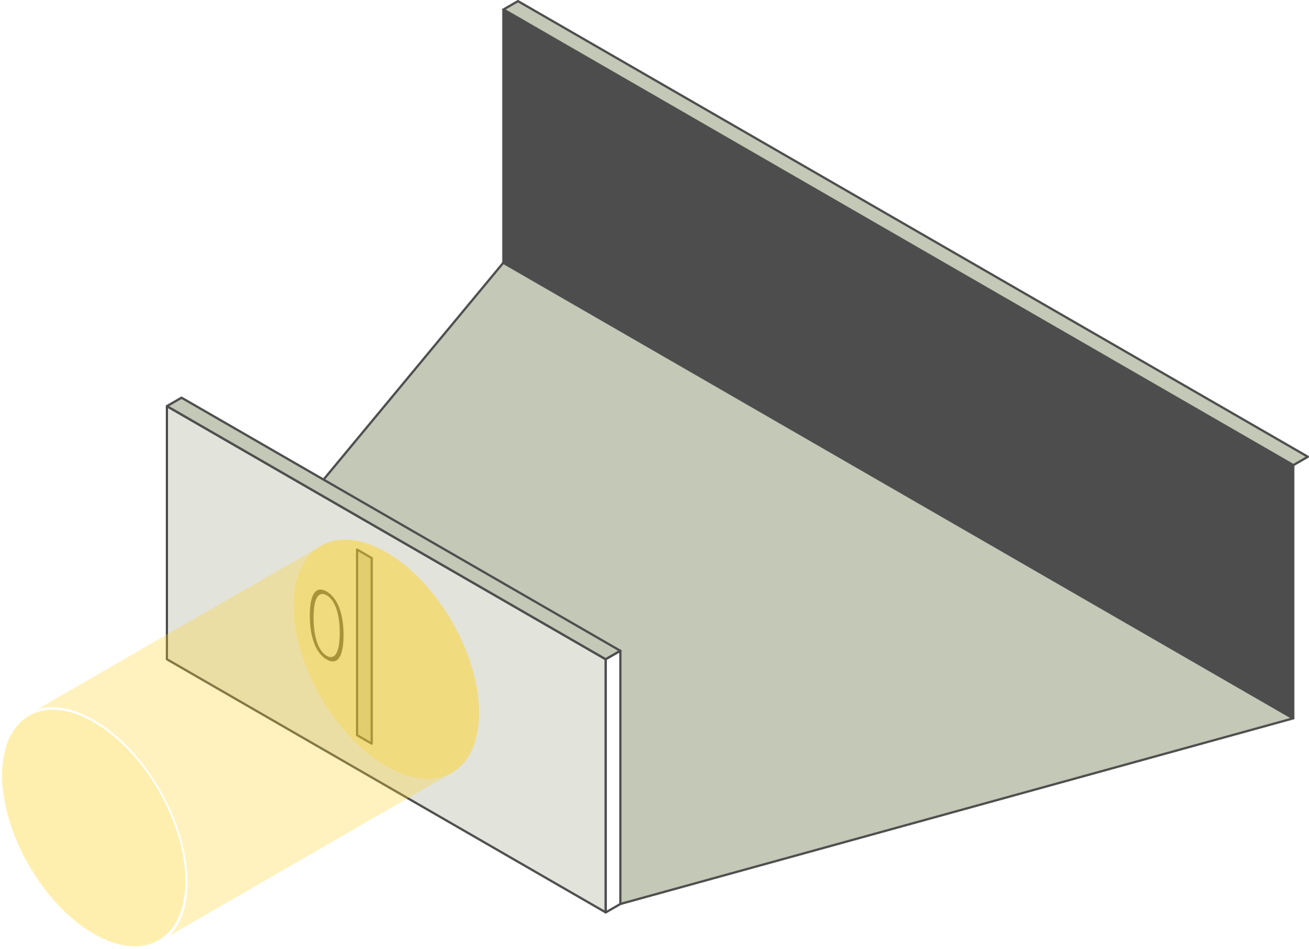
Young’s double-slit experiment
One narrow slit is
illuminated by a laser.
What would you
expect to see
on the screen?

Slide 3
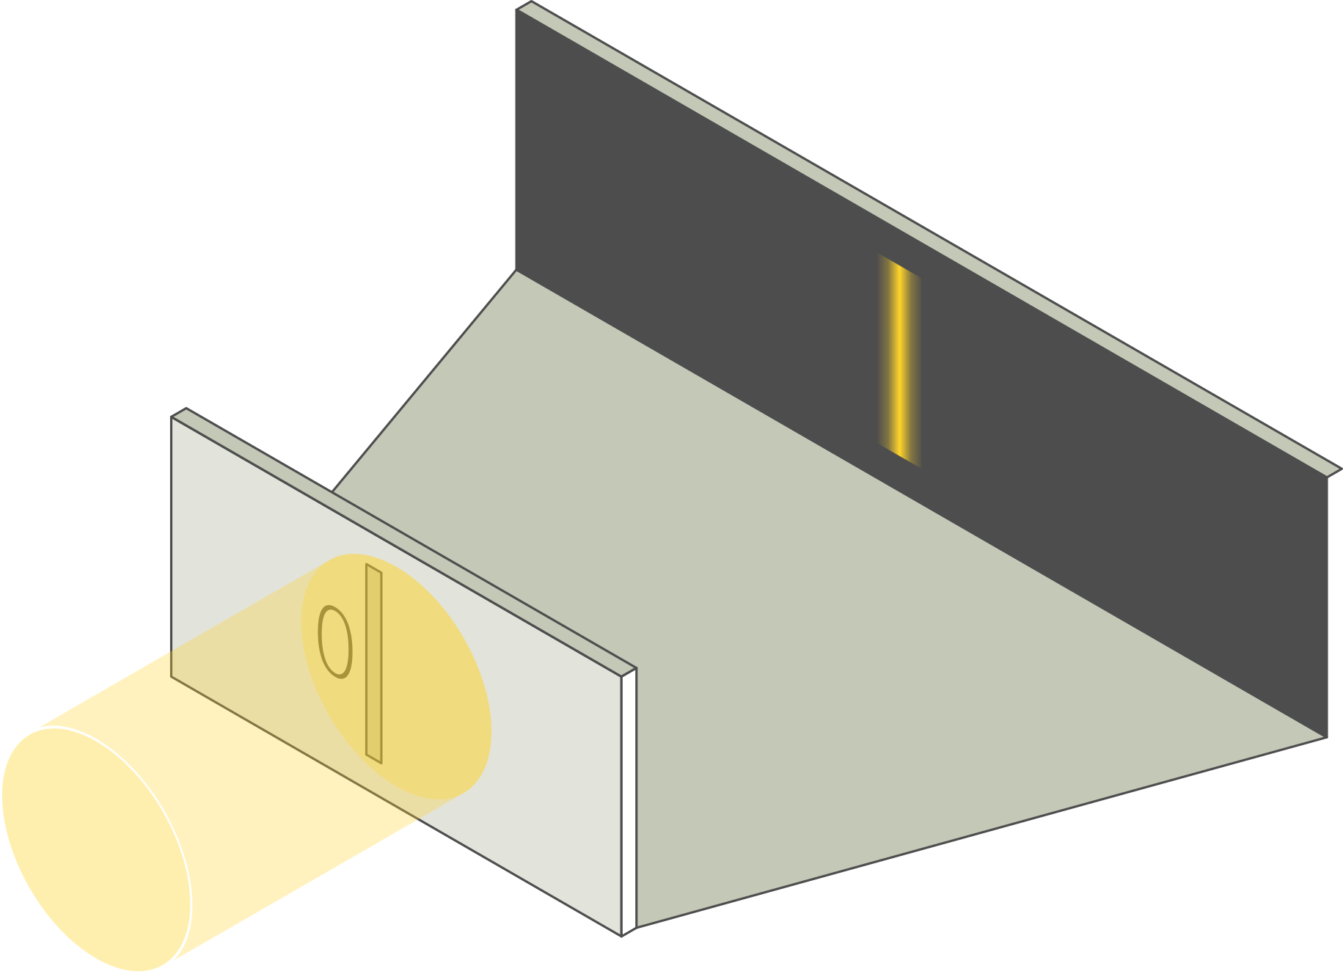
Young’s double-slit experiment
One narrow slit is
illuminated by a laser.
What would you
expect to see
on the screen?

Slide 4
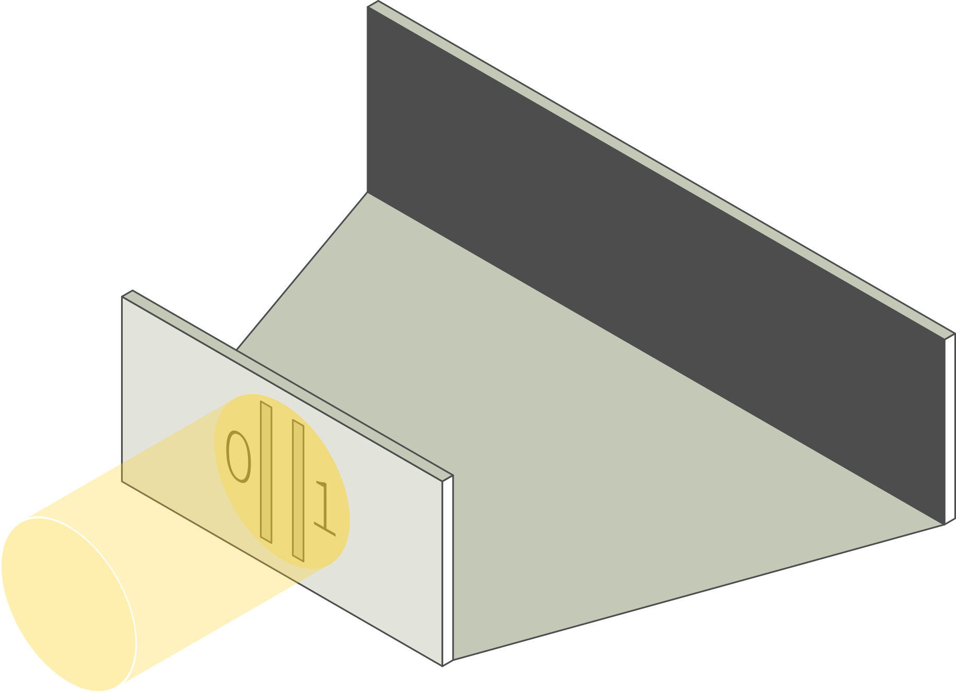
Young’s double-slit experiment
Two narrow slits are
illuminated by a laser.
What would you
expect to see
on the screen?

Slide 5
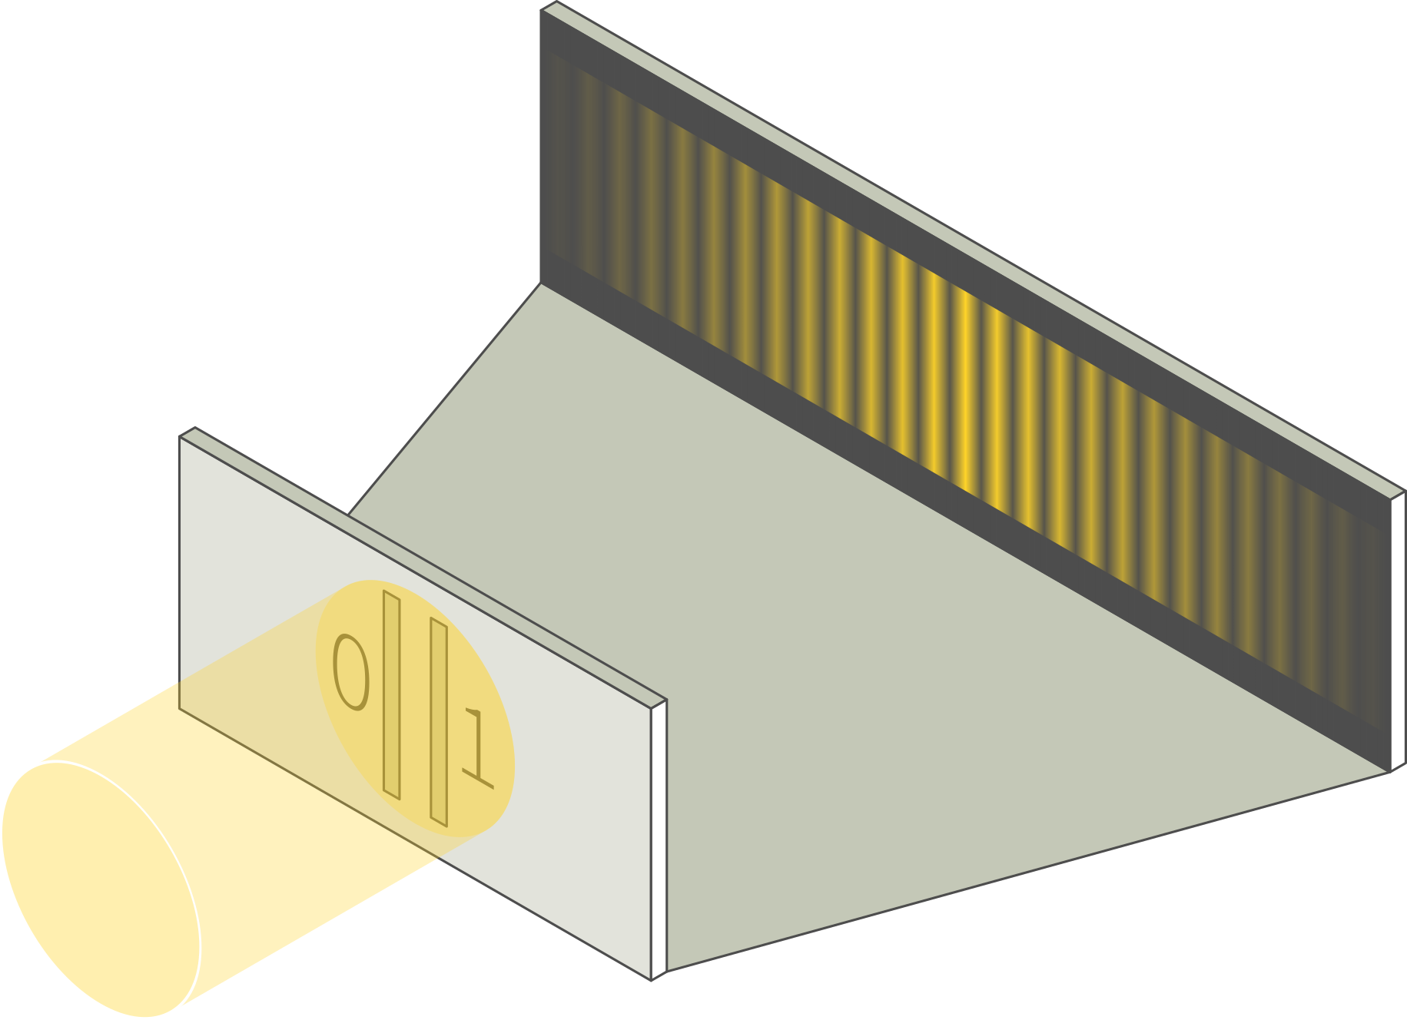
Young’s double-slit experiment
Two narrow slits are
illuminated by a laser.
What would you
expect to see
on the screen?

Slide 6
Young’s double-slit experiment
Suppose the light
intensity is gradually
reduced.
How will that affect
the fringe pattern?

Slide 7
Young’s double-slit experiment
Suppose the light
intensity is gradually
reduced.
Brightness of fringes
will decrease, while
positions and widths
will remain the same.

Slide 8
Young’s double-slit experiment
Energy of the beam
can be thought to be
carried by waves or
by particles (photons).
What if just a couple
of photons pass through
the slits every second?

Slide 9
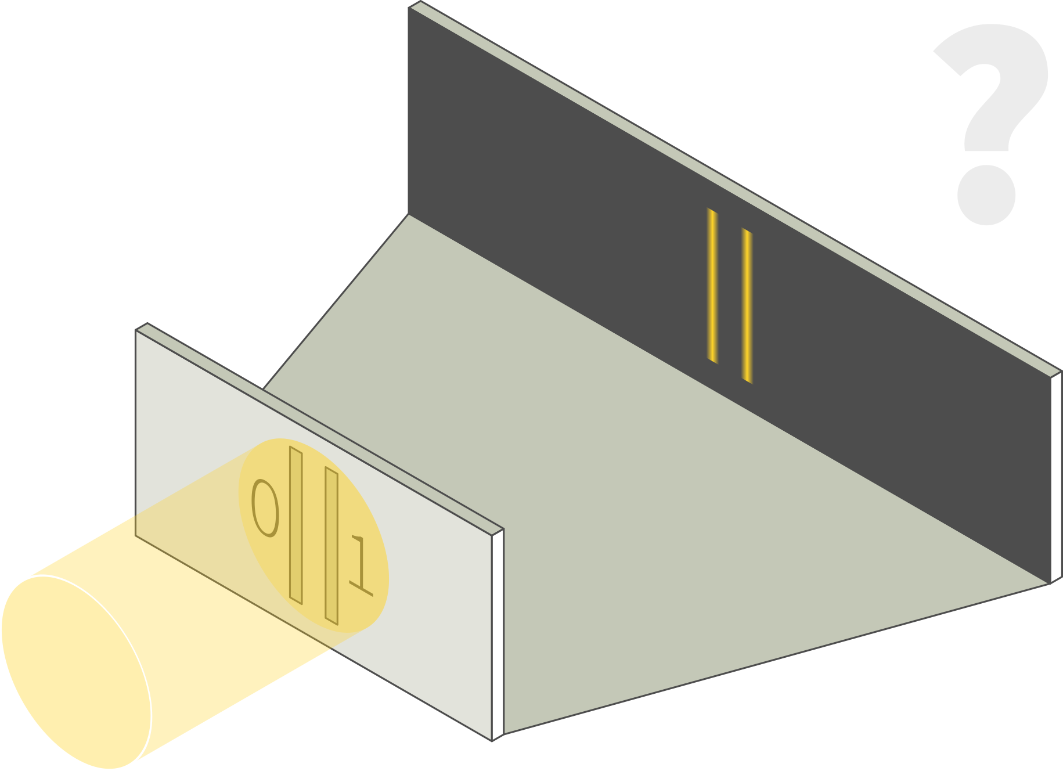
Young’s double-slit experiment
What if just a couple of
photons pass through
the slits every second?
Photons surely will
pass through either
one slit or the other
… right?

Slide 10
Young’s double-slit experiment
NO

Slide 11

Young’s double-slit experiment
Photons do hit
the screen at certain
points (so they really
are particles).
But the pattern
suggests that these
particles behave
like waves.

Slide 12
Quantum state
Every object can be
described by a state.
In this case, if photon
passes through slit 0,
it is in state |0⟩.
If it passes through
slit 1, it is in state |1⟩.

Slide 13
Quantum state
Classically, after the
slits, the photon
should be either in
state |0⟩ or state |1⟩.
Quantum physics says
it can as well be in
a superposition of
states |0⟩ and |1⟩.

Slide 14
Quantum state
Classically, after the
slits, the photon
should be either in
state |0⟩ or state |1⟩.
Quantum physics says
it can as well be in
a superposition of
states |0⟩ and |1⟩.
The photon passes through both slits
at the same time.

Slide 15
Quantum state
|c₀|² and |c₁|² are
probabilities that the
photon has passed
through slit 0 or slit 1.
We cannot be sure
which slit the photon
passed through.

Slide 16
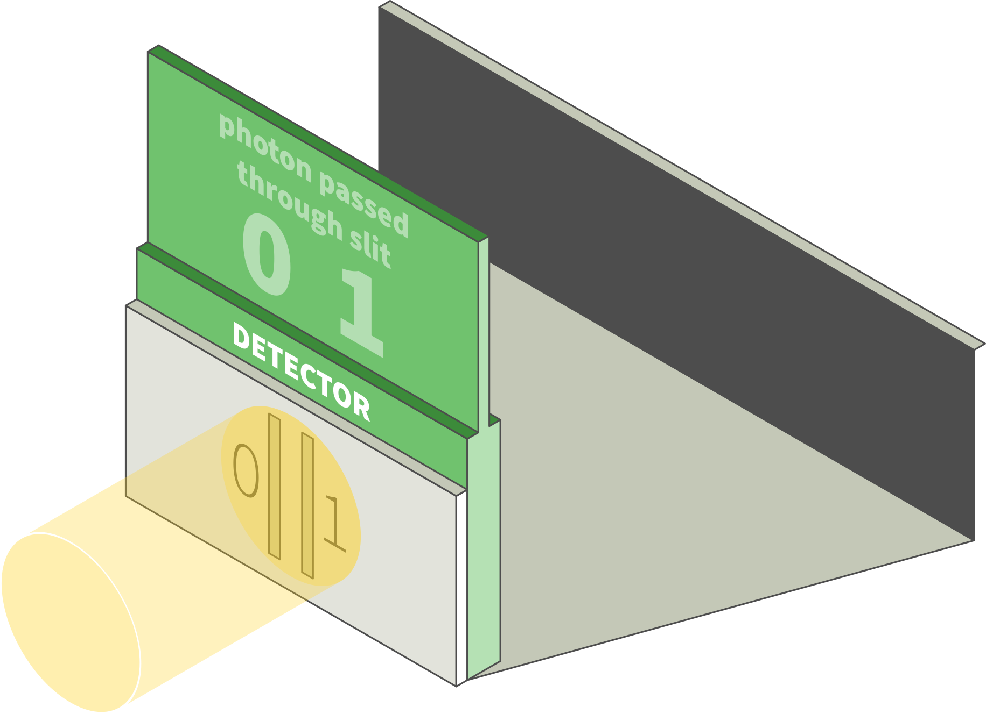
Measurement
Measurement
outcome is a number
(with units) – just like
in the classical case.
Each outcome can be
measured with a
certain probability.

Slide 17
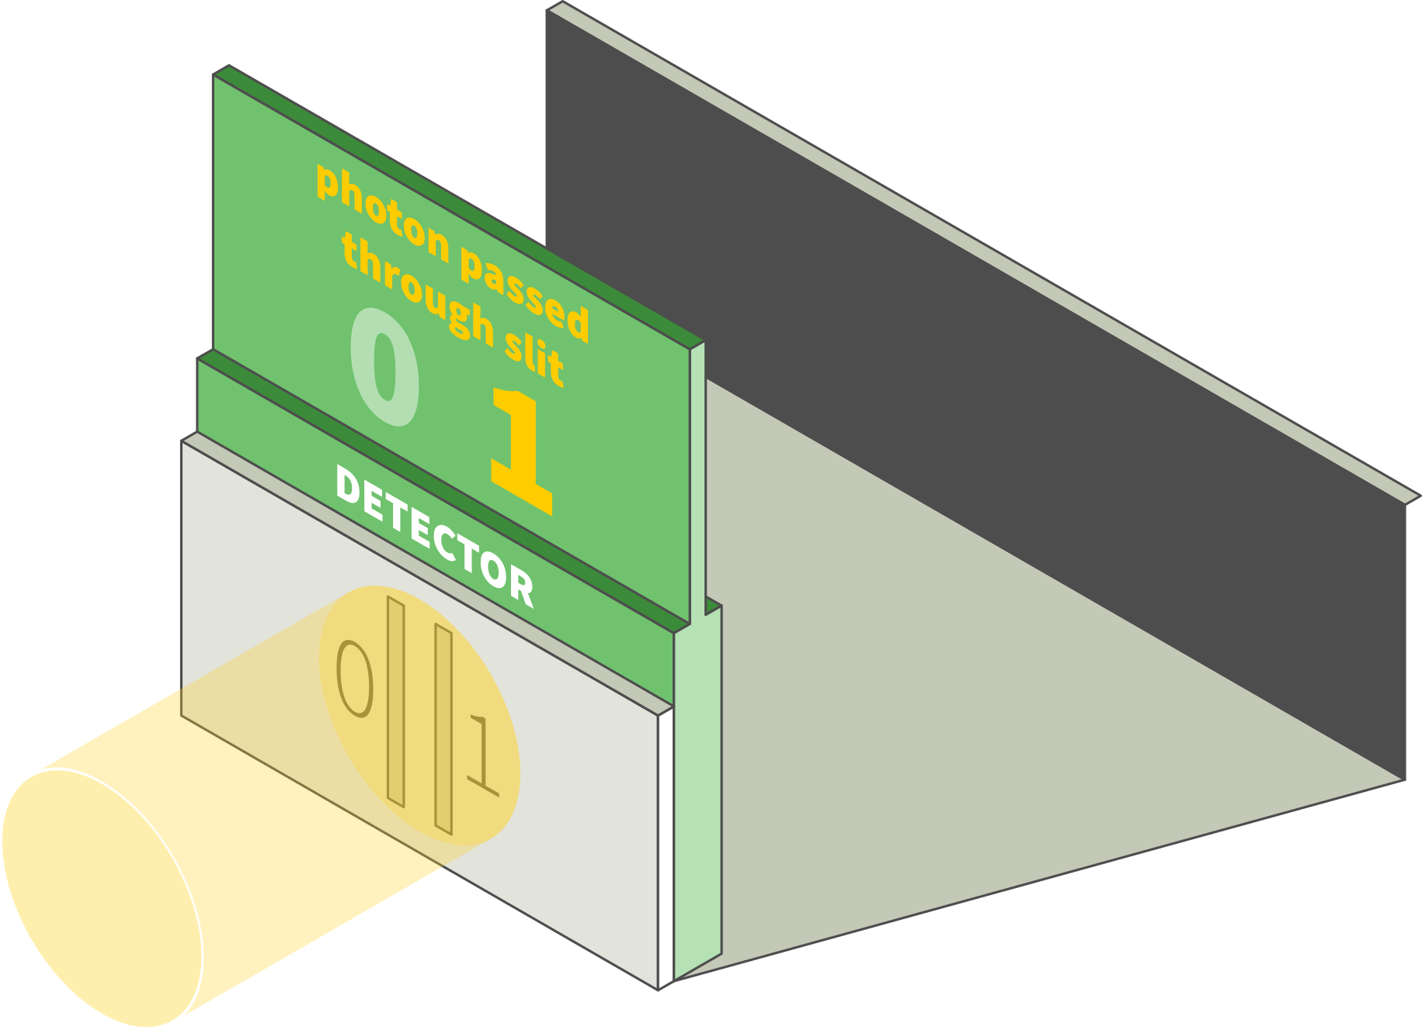
Measurement
The state is destroyed
during the quantum
measurement unlike
in the classical case.
All uncertainty is lost
in the measurement.

Slide 18
Measurement
The state is destroyed
during the quantum
measurement unlike
in the classical case.
All uncertainty is lost
in the measurement.
MEASUREMENT

Slide 19
Measurement
But how do we get
c₀ and c₁ if we cannot
repeat a
measurement without
destroying the state?
MEASUREMENT

Slide 20
Measurement
But how do we get
c₀ and c₁ if we cannot
repeat a
measurement without
destroying the state?
Just make copies of
the system.
No | Out
1 | |1⟩
2 | |1⟩
3 | |1⟩
4 | |0⟩
5 | |1⟩
6 | |1⟩
No | Out
7 | |1⟩
8 | |1⟩
9 | |1⟩
10 | |0⟩
11 | |1⟩
12 | |1⟩
No | Out
13 | |1⟩
14 | |0⟩
15 | |1⟩
16 | |1⟩
17 | |0⟩
18 | |1⟩

Slide 21
Entanglement
Two photons, A and B,
pass through a
double slit.
How can you describe
the state of these
photons?

Slide 22

Entanglement
Two photons, A and B,
pass through a
double slit.
How can you describe
the state of these
photons?

Slide 23
Entanglement
What changes if the
two photons are not
independent?

Slide 24
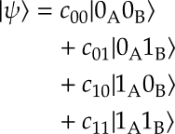
Entanglement
In this case, photons
cannot be described
separately.
The two-photon
system is described
as one whole.

Slide 25
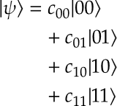
Entanglement
Notation can be
simplified by dropping
indices A and B, but
the ordering of 0’s and
1’s is still important.

Slide 26
Entanglement
Two photons A and B
are in the state |ψ ⟩.
Only photon A is
measured.
What can be said
about the state of
the photon B?

Slide 27
Entanglement
Two photons A and B
are in the state |ψ ⟩.
Only photon A is
measured.
What can be said
about the state of
the photon B?
A has passed
through slit 0
▼
B has passed
through slit 1
A has passed
through slit 1
▼
B has passed
through slit 0

Slide 28
Entanglement
Measuring the state of
one photon gives full
information about the
state of the other
photon.
Photon states are fully
entangled.
A has passed
through slit 0
▼
B has passed
through slit 1
A has passed
through slit 1
▼
B has passed
through slit 0

Slide 29
Problems and activities

Slide 30
Problem: States and measurements
The system is initialised in the state 0.6 |0⟩ – 0.8 |1⟩.
If the system is in the state |i⟩, the outcome of the measurement is i.
The system has now been measured.
Can you determine the outcome of the measurement? Explain.

Slide 31
Problem: States and measurements
The system is initialised in the state 0.6 |0⟩ – 0.8 |1⟩.
If the system is in the state |i⟩, the outcome of the measurement is i.
The system has now been measured.
Suppose the result of this measurement is 0. Another measurement is performed right after the first one.
Can you determine the outcome of the measurement? Explain.

Slide 32
Problem: States and measurements
The system is initialised in the state 0.6 |0⟩ – 0.8 |1⟩.
If the system is in the state |i⟩, the outcome of the measurement is i.
The system has now been measured.
1000 identical copies of the original system are made and each one is measured once.
Estimate the number of outcomes 0 and the number of outcomes 1.

Slide 33
Problem: States and measurements
The system is initialised in the state 0.6 |0⟩ – 0.8 |1⟩.
If the system is in the state |i⟩, the outcome of the measurement is i.
The system has now been measured.
1000 identical copies of the original system are made and each one is measured once.
Estimate the mean value of a measurement outcome.

Slide 34
Activity: Modelling a measurement

